Slide 1
Summary
Density
Quick run through of the process
Current cp values
Thermogram double peaks

Slide 2
Density Differences
Standard density (28-30wt%, 15C) = 0.9 g/ml
Old bottle measured density (20wt%, ?C) = 0.7885 g/ml
New bottle measured density (27wt%, ?C) = 0.6158 g/ml
Not sure what causes the density difference
Lower density, lower calculated wt%
Impact on cp discussed later

Slide 3
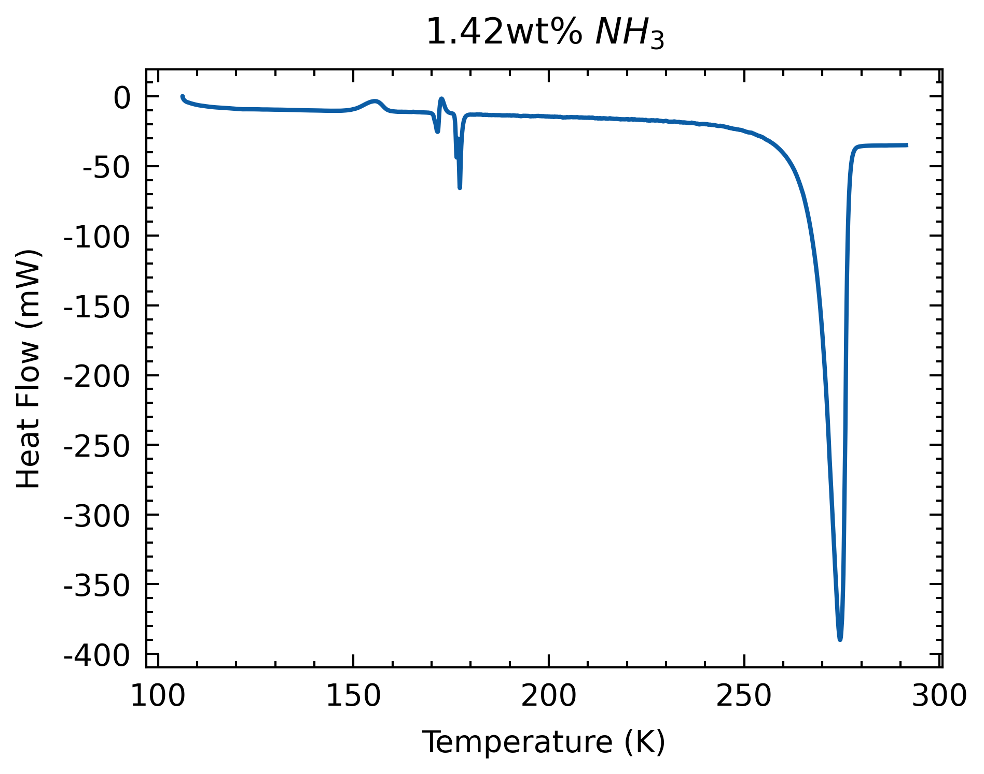
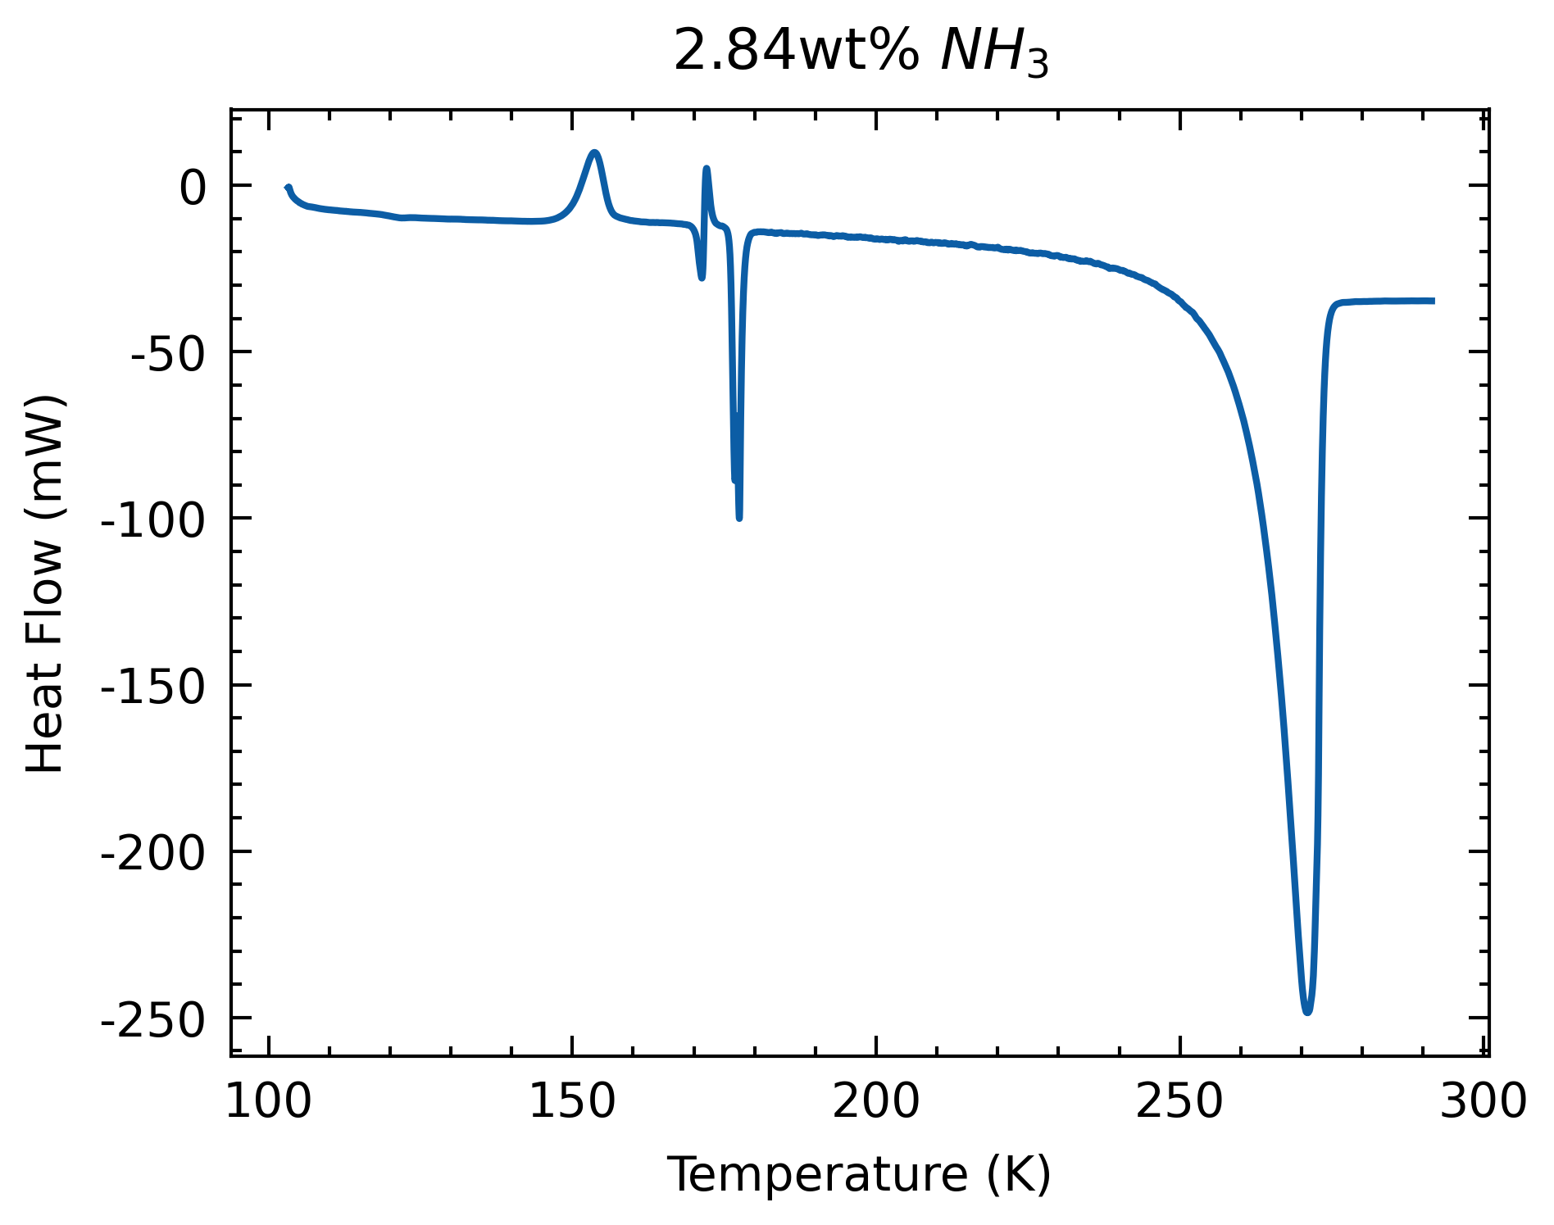
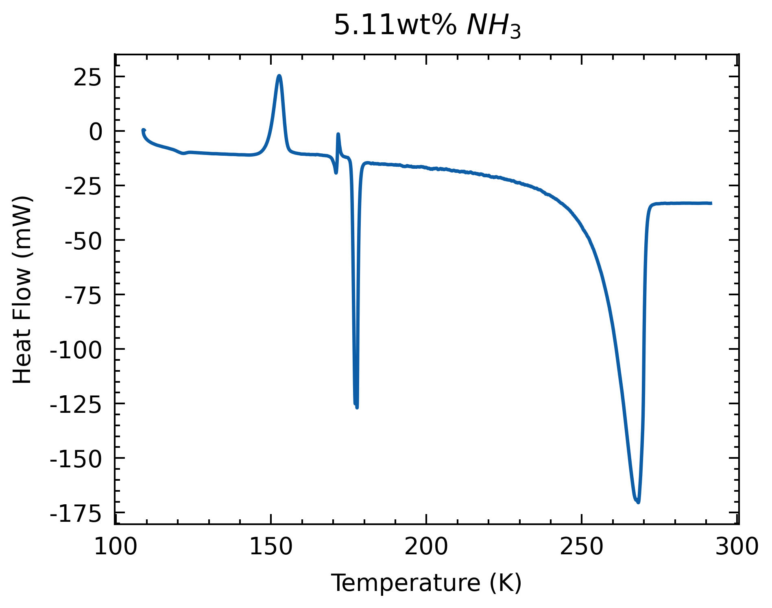
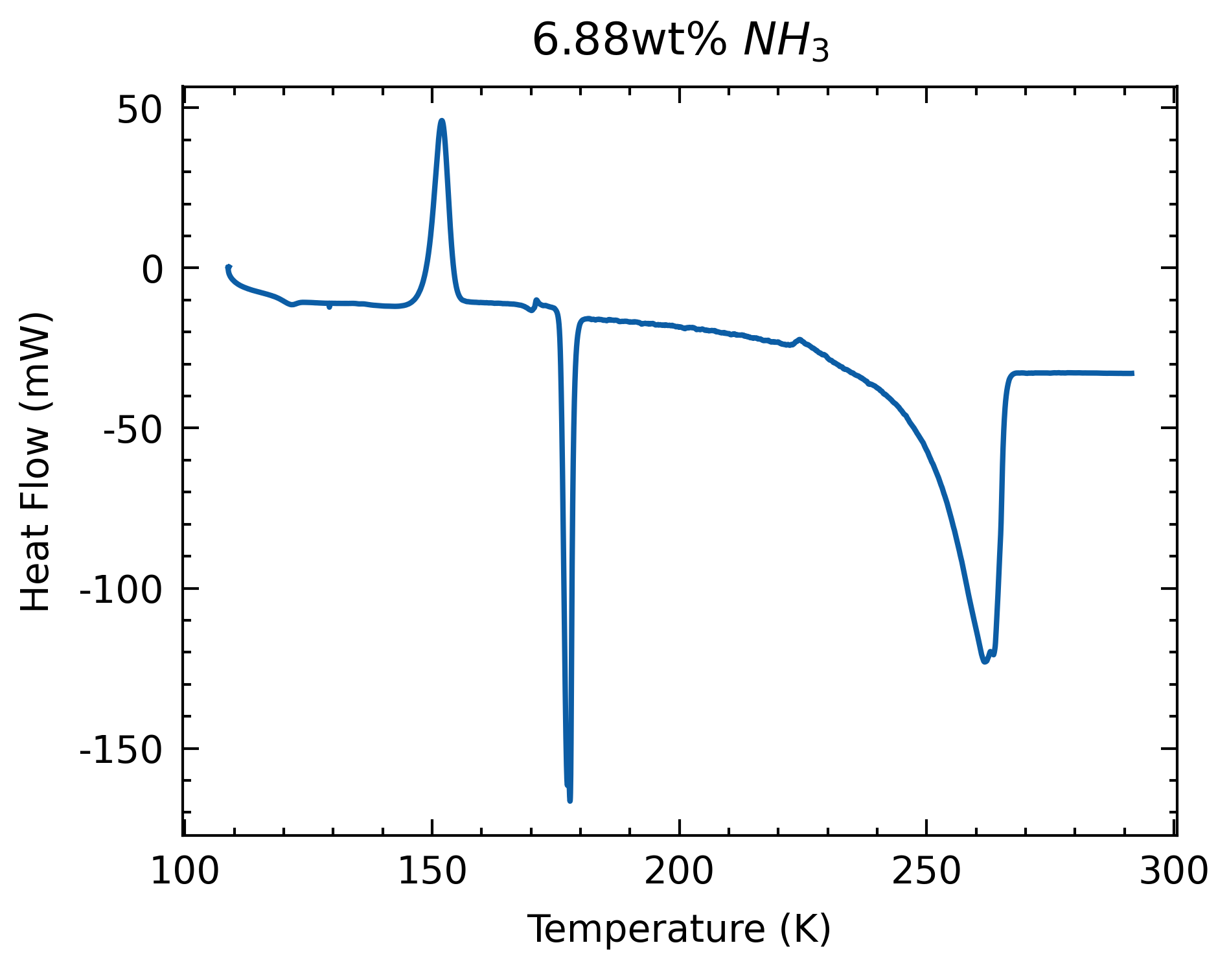
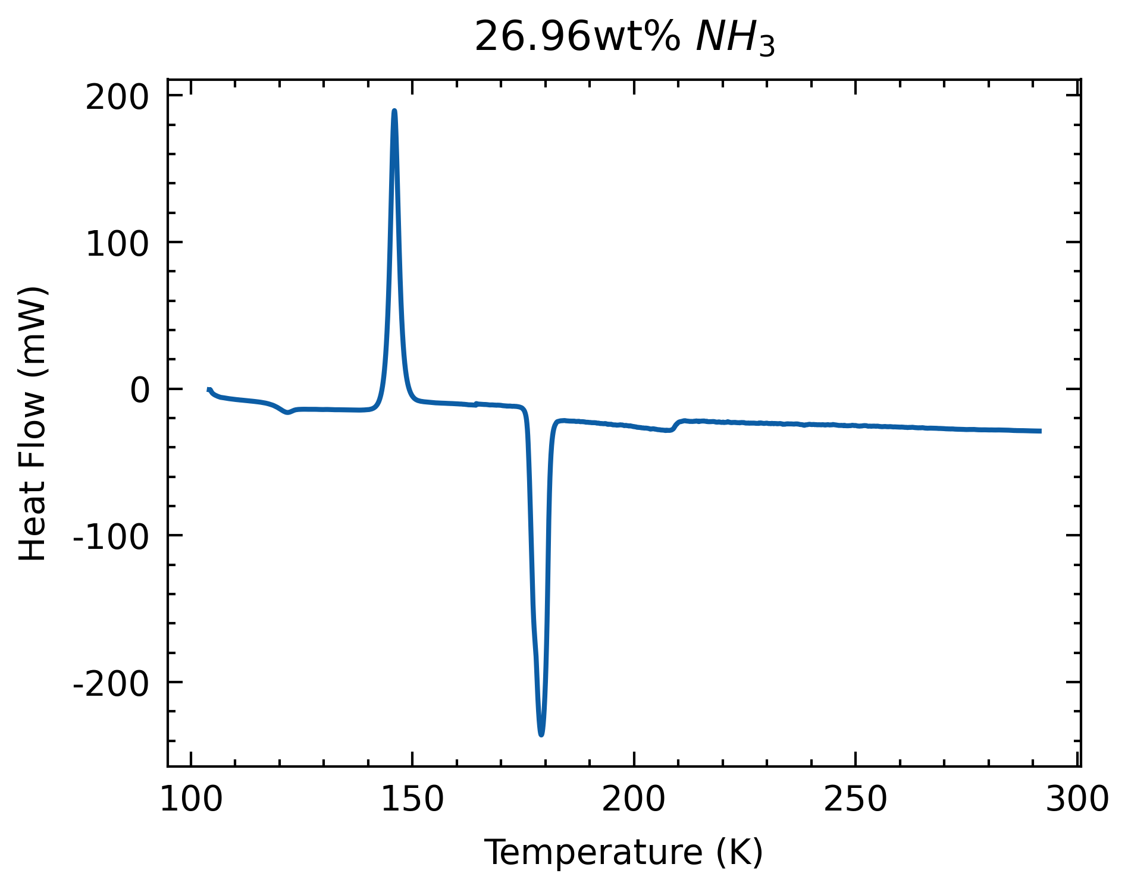
Process
Start with thermogram

Slide 4
Process
Thermogram offsets
Samples | ADH Melt (K) | Offset (K) | H2O (K) | Offset (K) | Liquidus (K)
0 wt. % | - | - | 273.72 | 0.57 | 273.15
1.42wt% | 175.85 | -0.15 | 274.54 | 2.47 | 272.07
2.84wt% | 175.99 | 0.00 | 271.011 | 0.48 | 270.53
5.11wt% | 175.98 | -0.02 | 268.21 | 0.82 | 267.39
6.88wt% | 175.98 | -0.02 | 262.89 | -1.67 | 264.56

Slide 5
Process
Start with thermogram
Extract cp from partial melt regime & pure liquid phase

Slide 6
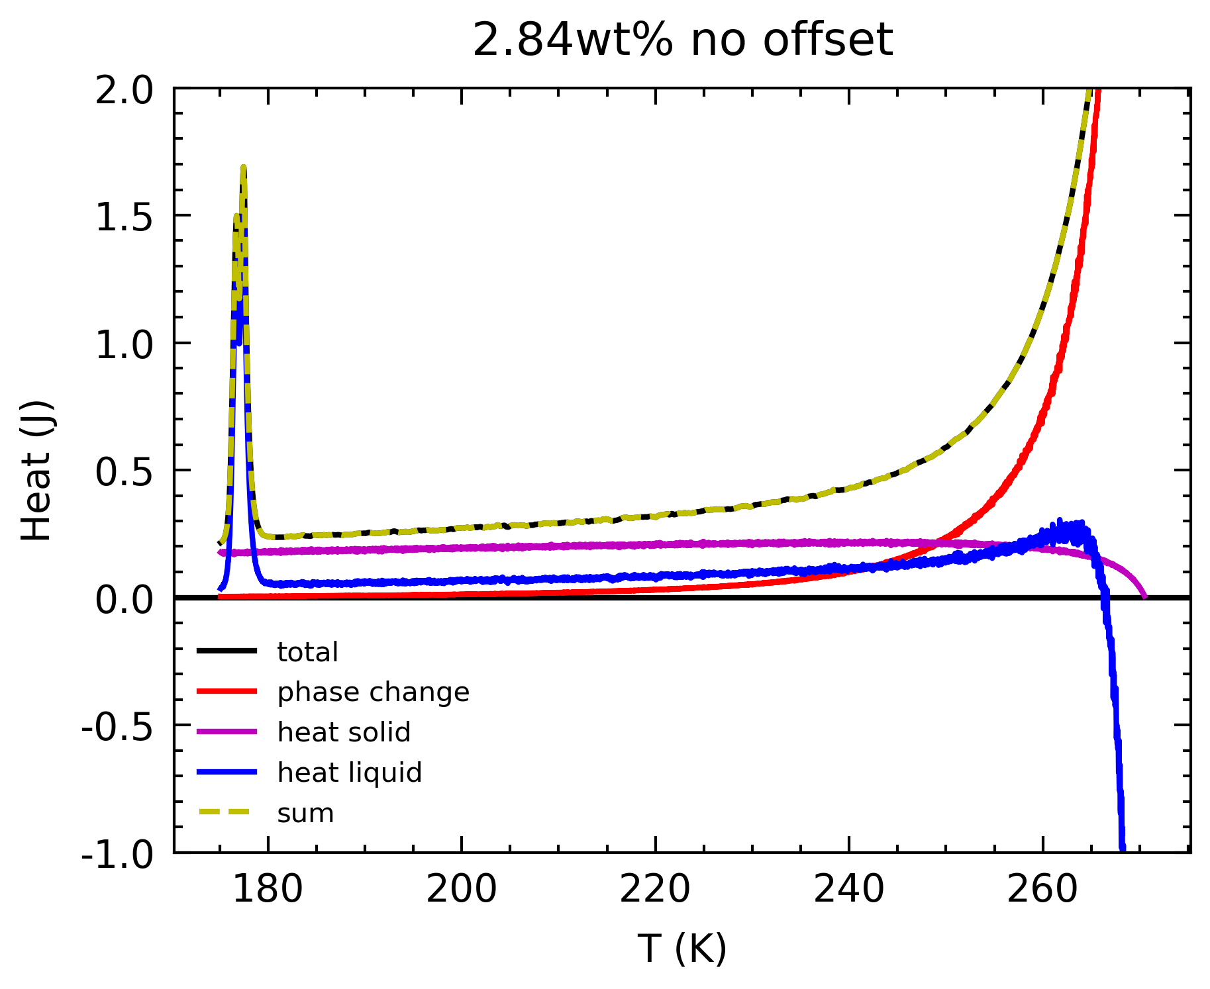
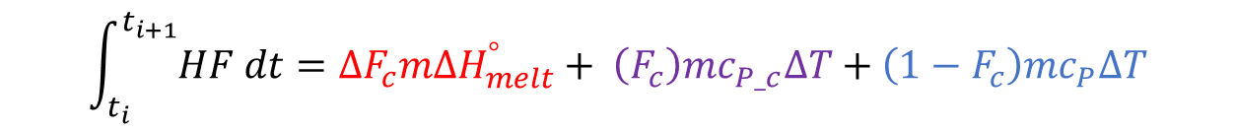
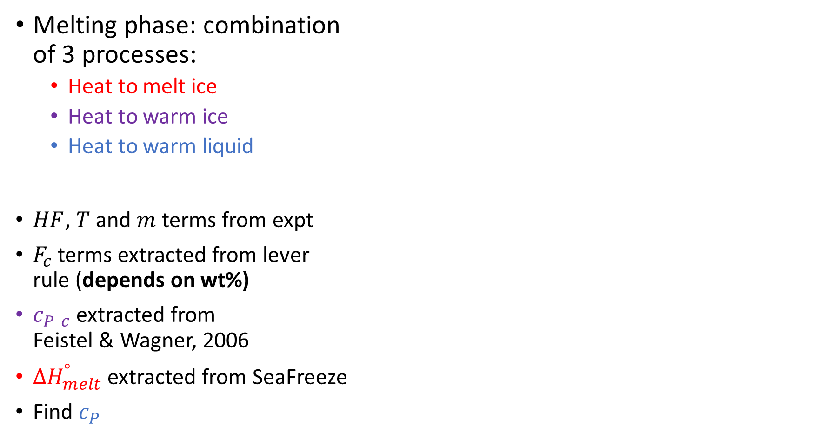
$$\int_{t_{i}}^{t_{i+1}}{HF dt}=∆F_{c}m{∆H}_{melt}^{°}+ {\left(F_{c}\right)mc}_{P_c}∆T+\left(1−F_{c}\right)mc_{P}∆T$$
Deconvolution
Melting phase: combination of 3 processes:
Heat to melt ice
Heat to warm ice
Heat to warm liquid
$HF$, $T$ and $m$terms from expt
$F_{c}$ terms extracted from lever rule (depends on wt%)
$c_{P_c}$ extracted from Feistel & Wagner, 2006
${∆H}_{melt}^{°}$ extracted from SeaFreeze
Find $c_{P}$

Slide 7
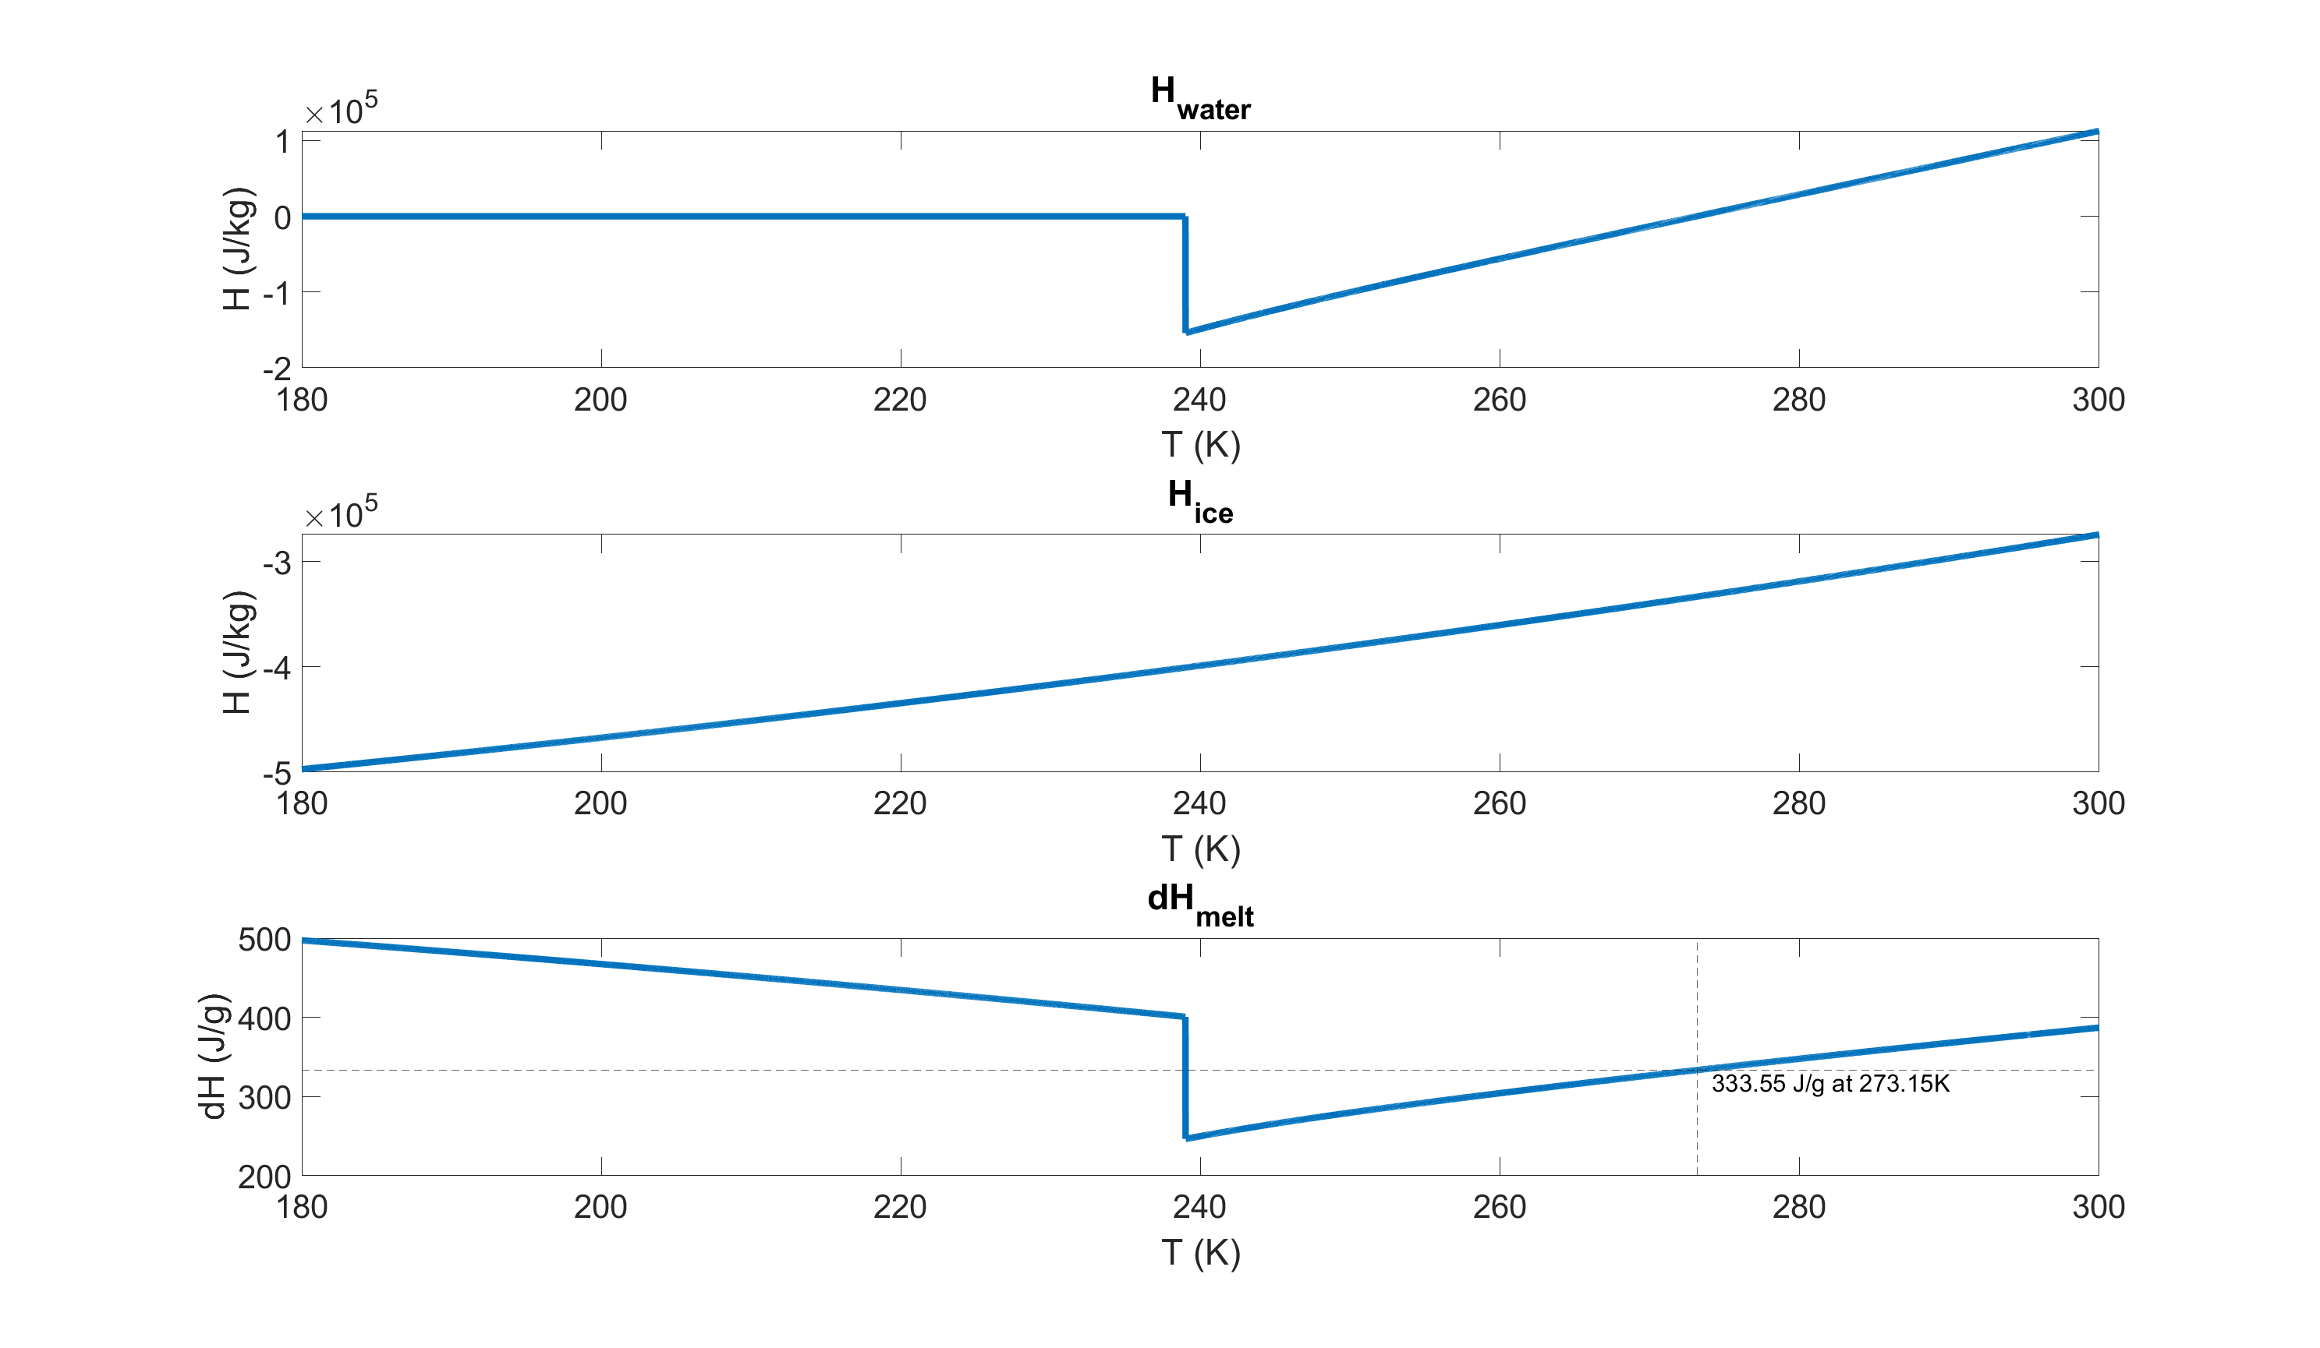
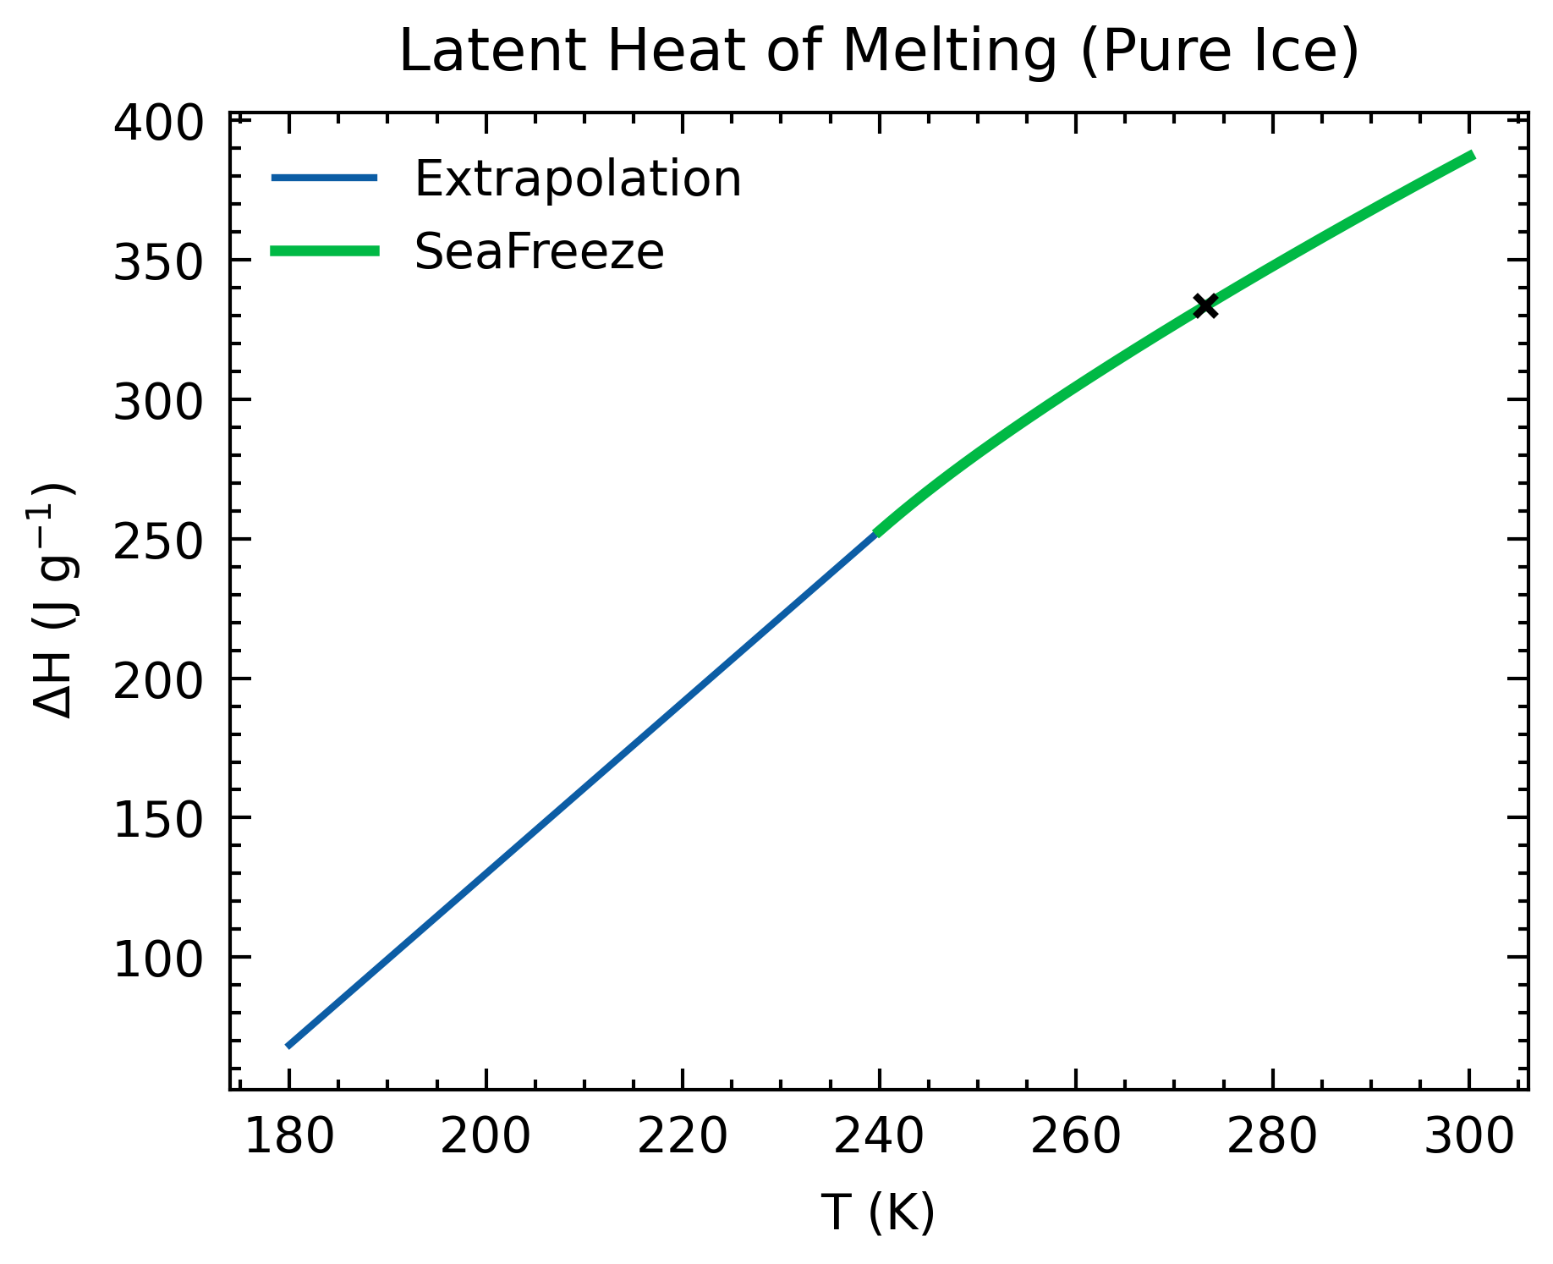

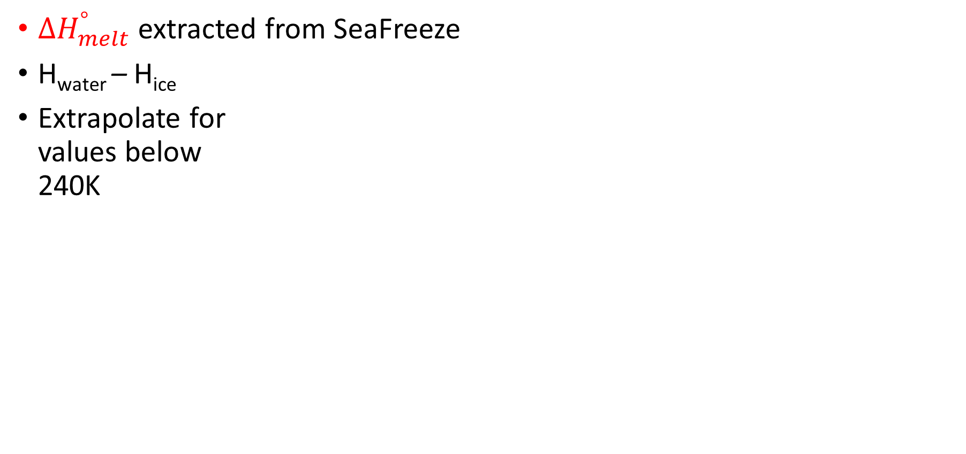
$$\int_{t_{i}}^{t_{i+1}}{HF dt}=∆F_{c}m{∆H}_{melt}^{°}+ \left(F_{c}\right)mc_{P_c}∆T+\left(1−F_{c}\right)mc_{P}∆T$$
Latent Heat
${∆H}_{melt}^{°}$ extracted from SeaFreeze
H_{water} – H_{ice}
Extrapolate for values below 240K

Slide 8
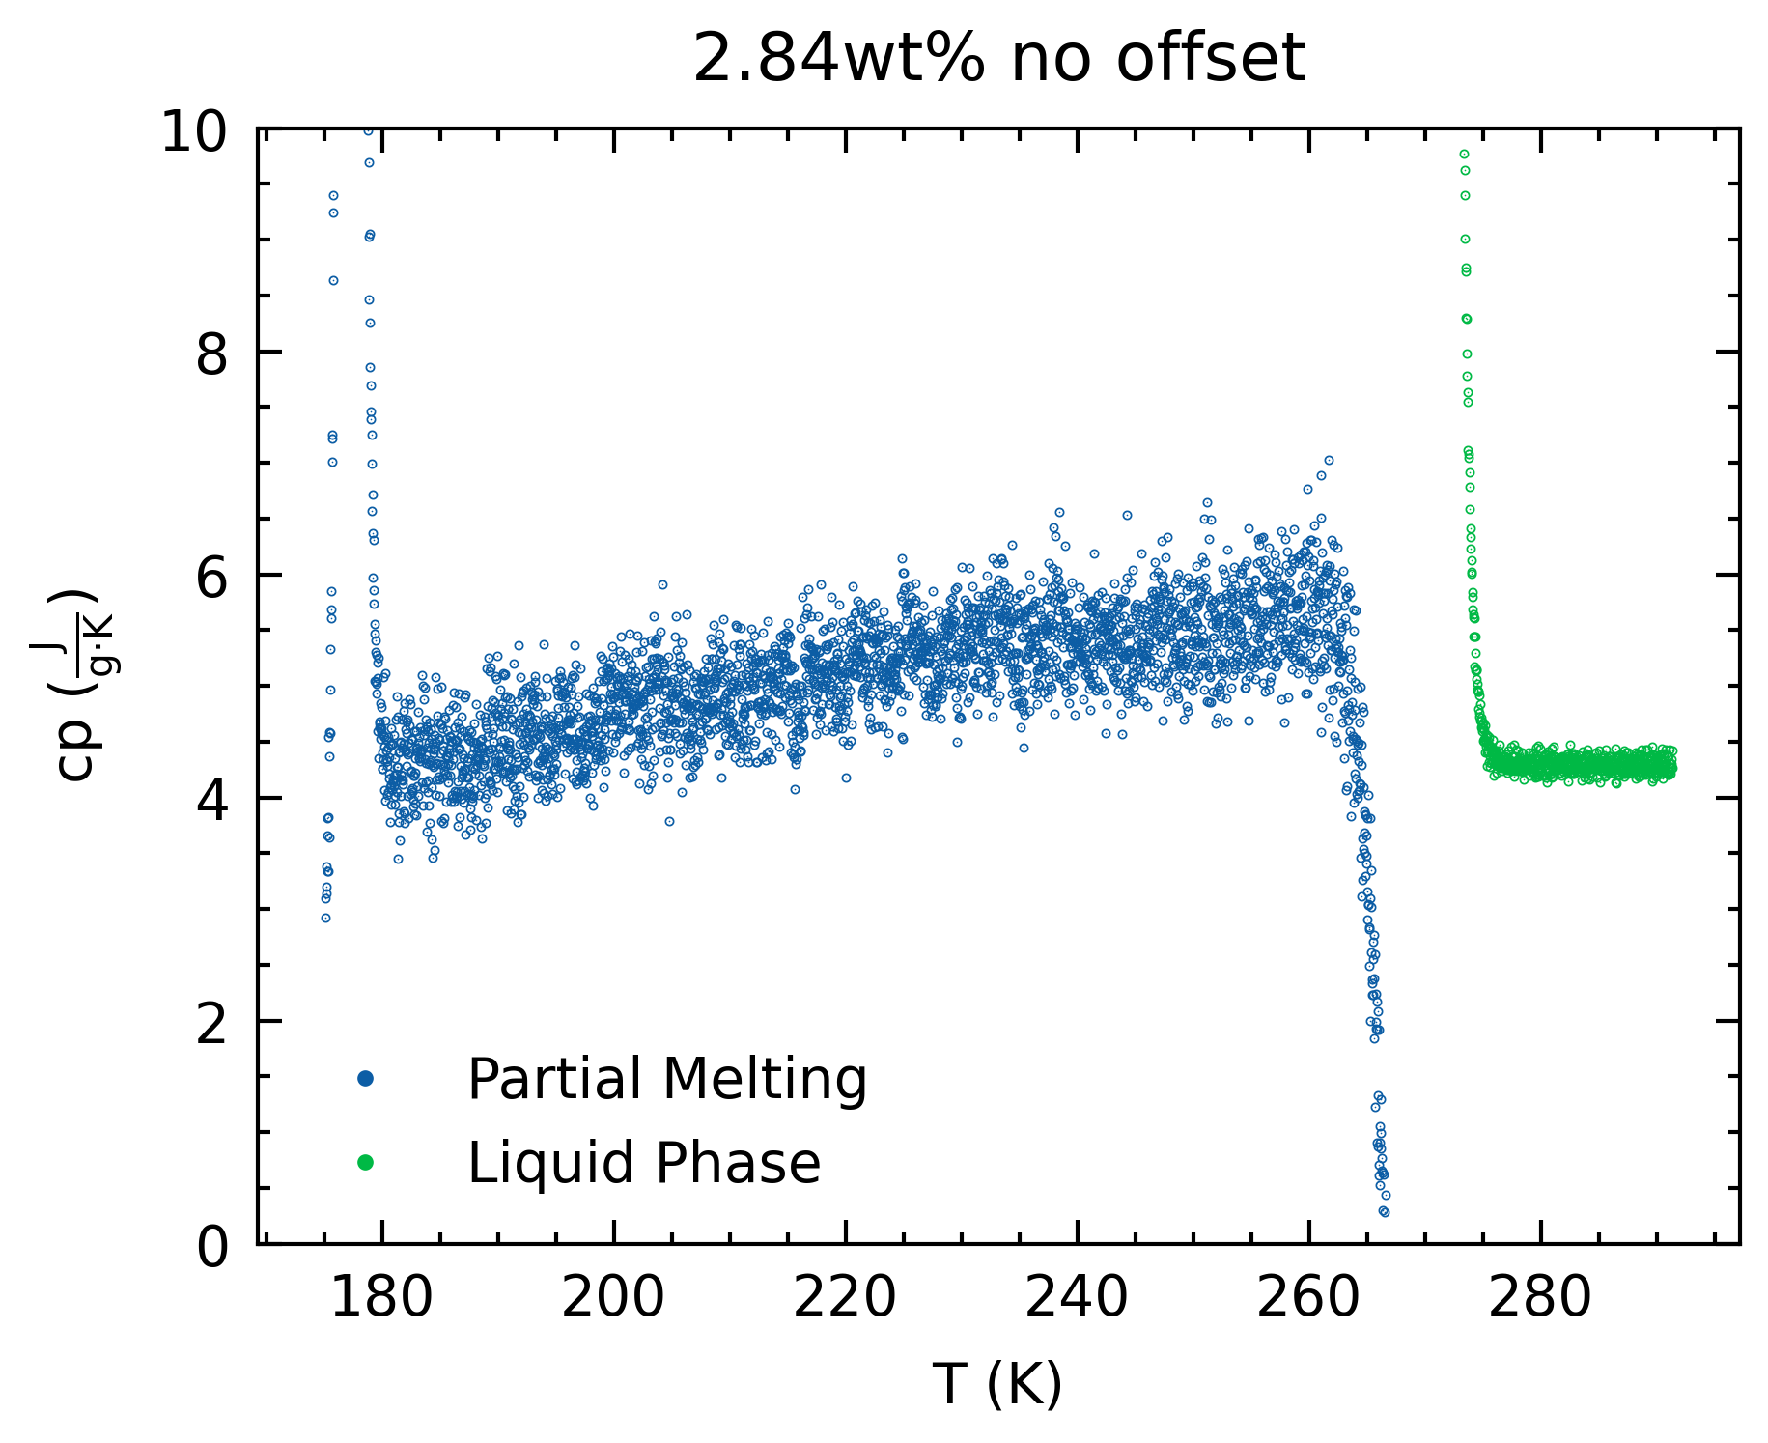
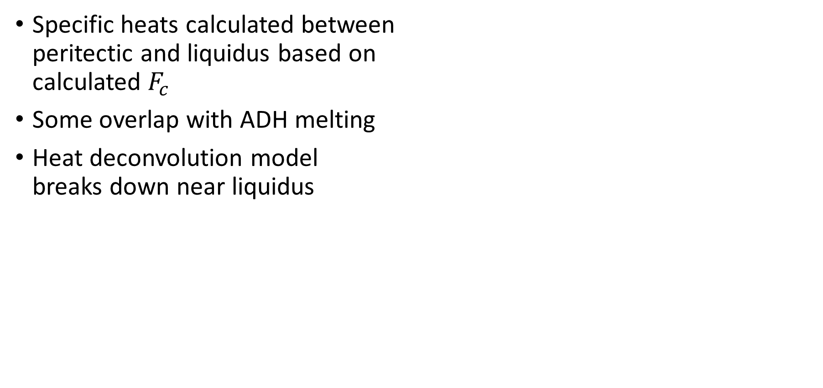
Specific Heat
Specific heats calculated between peritectic and liquidus based on calculated $F_{c}$
Some overlap with ADH melting
Heat deconvolution model breaks down near liquidus

Slide 9
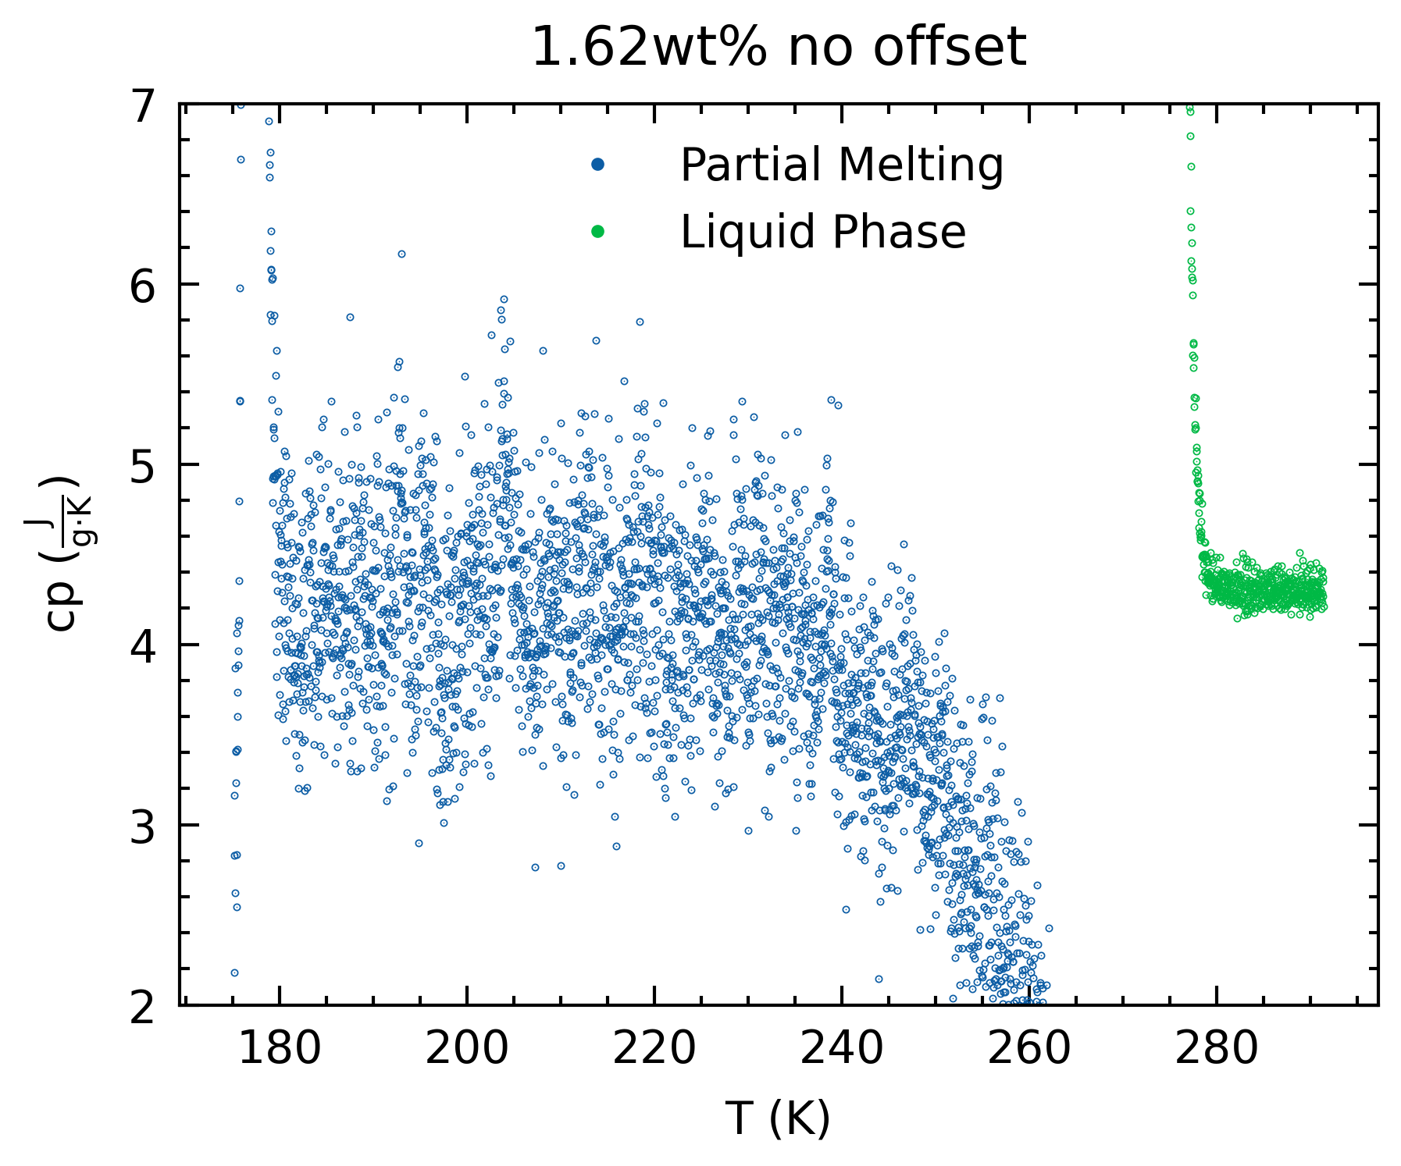
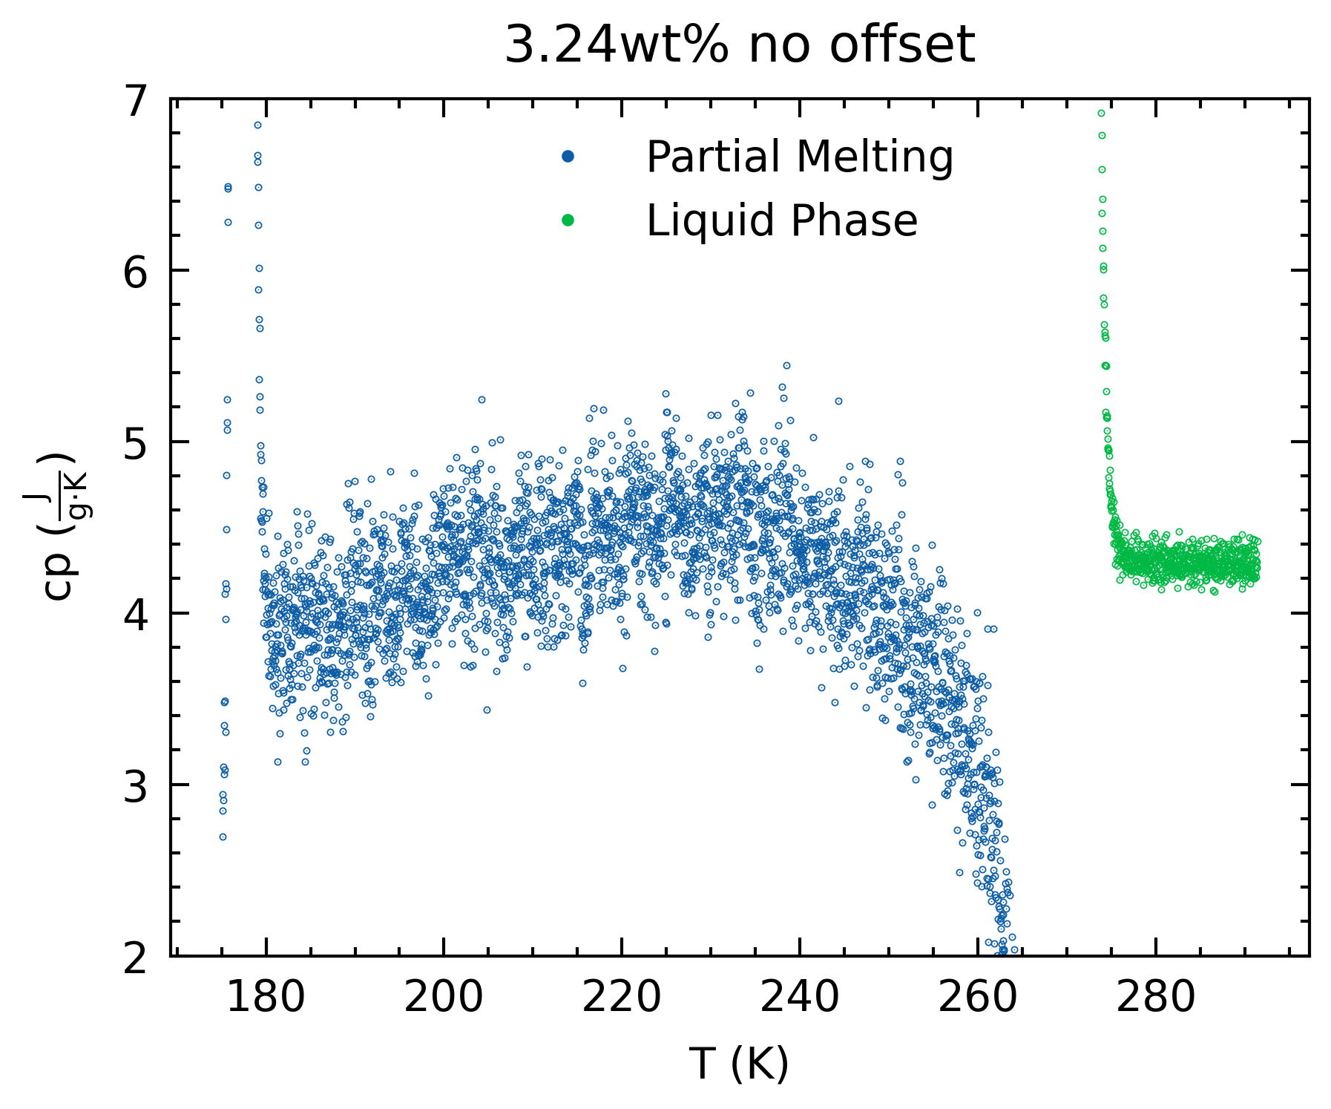
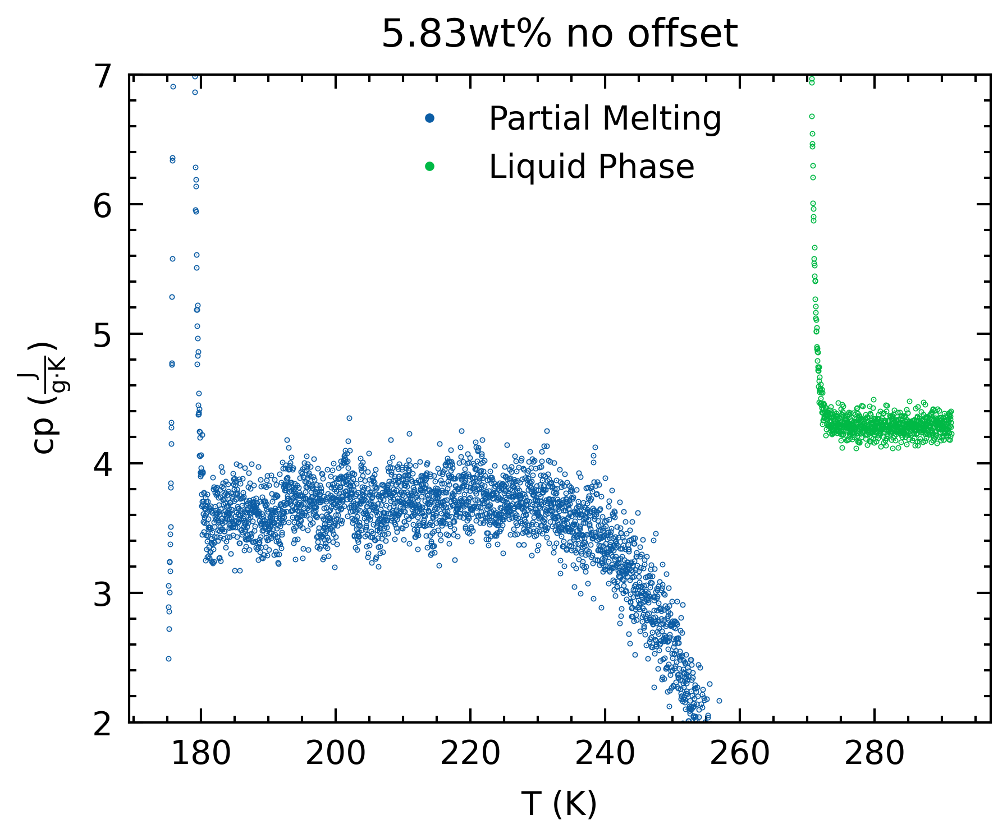
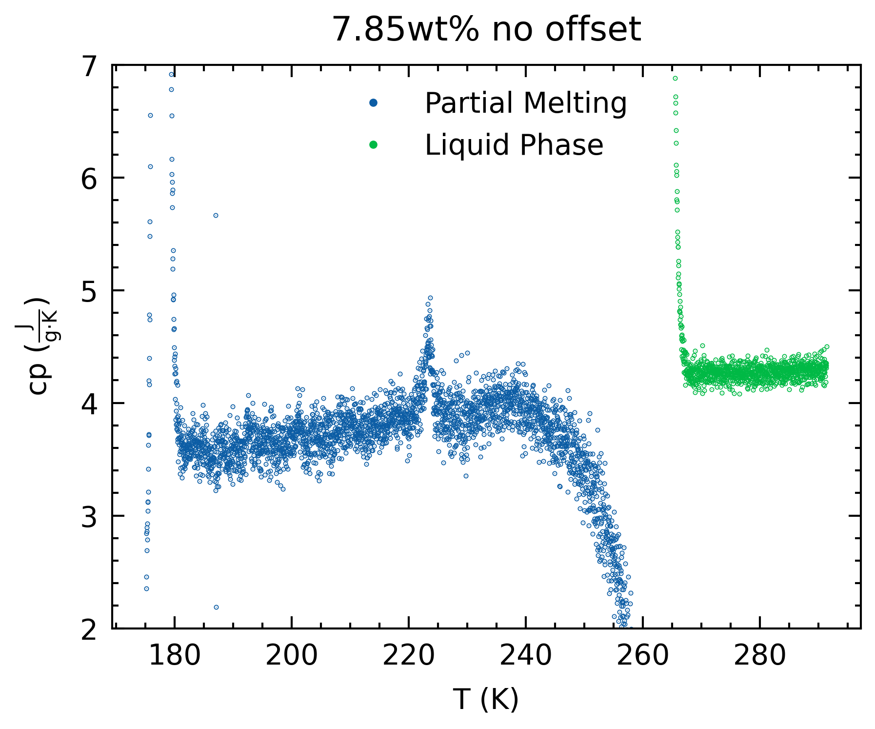
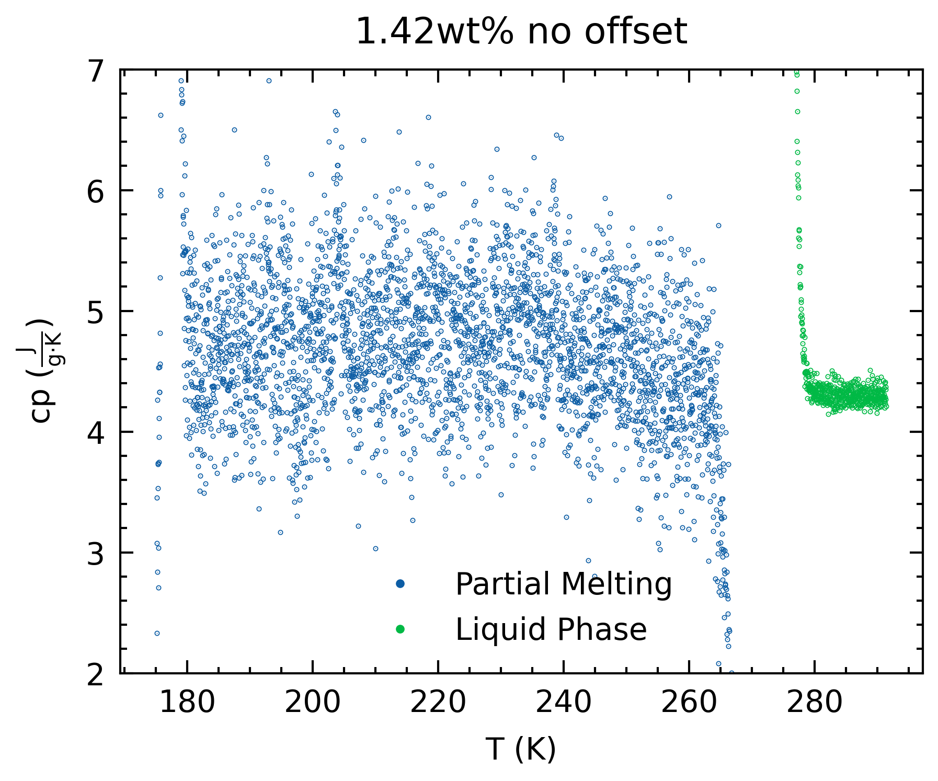
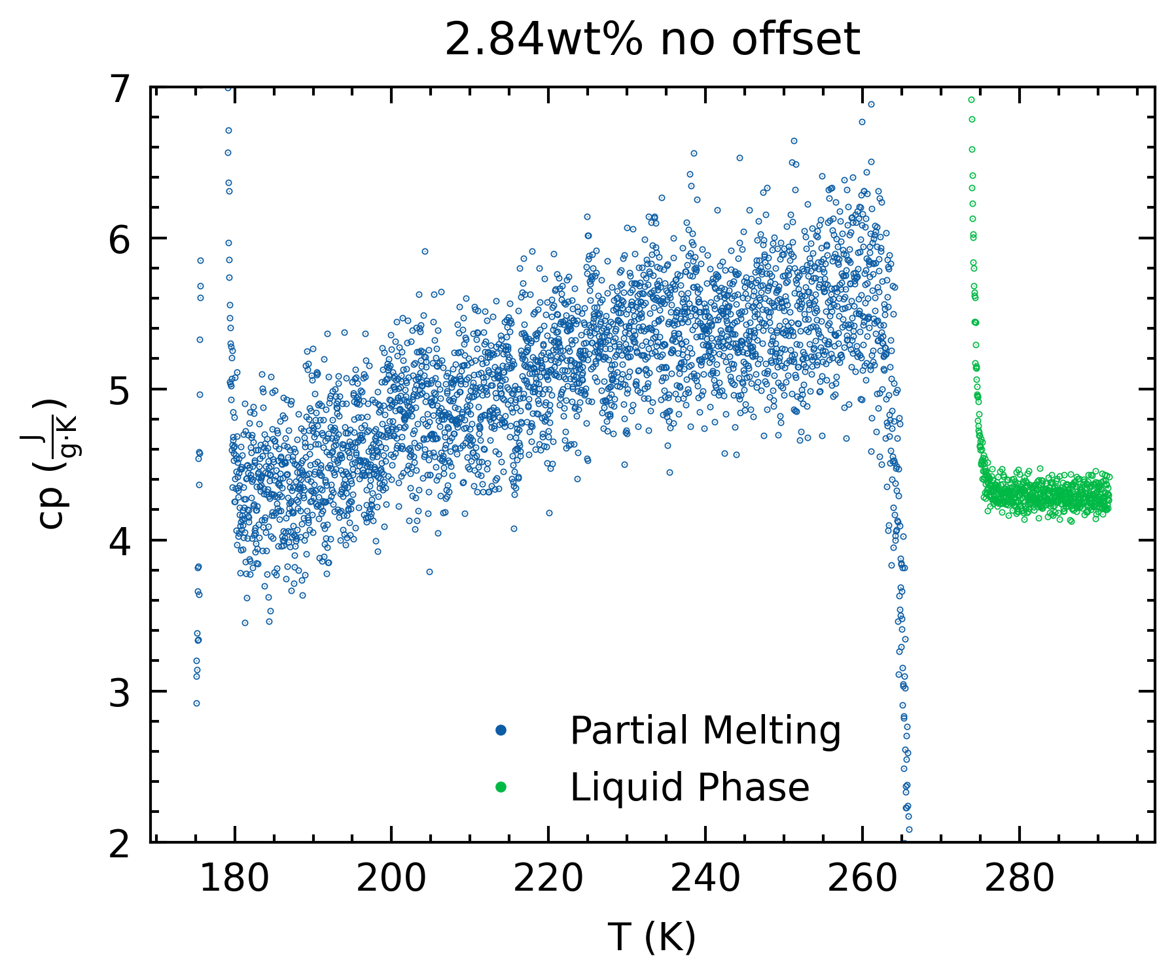
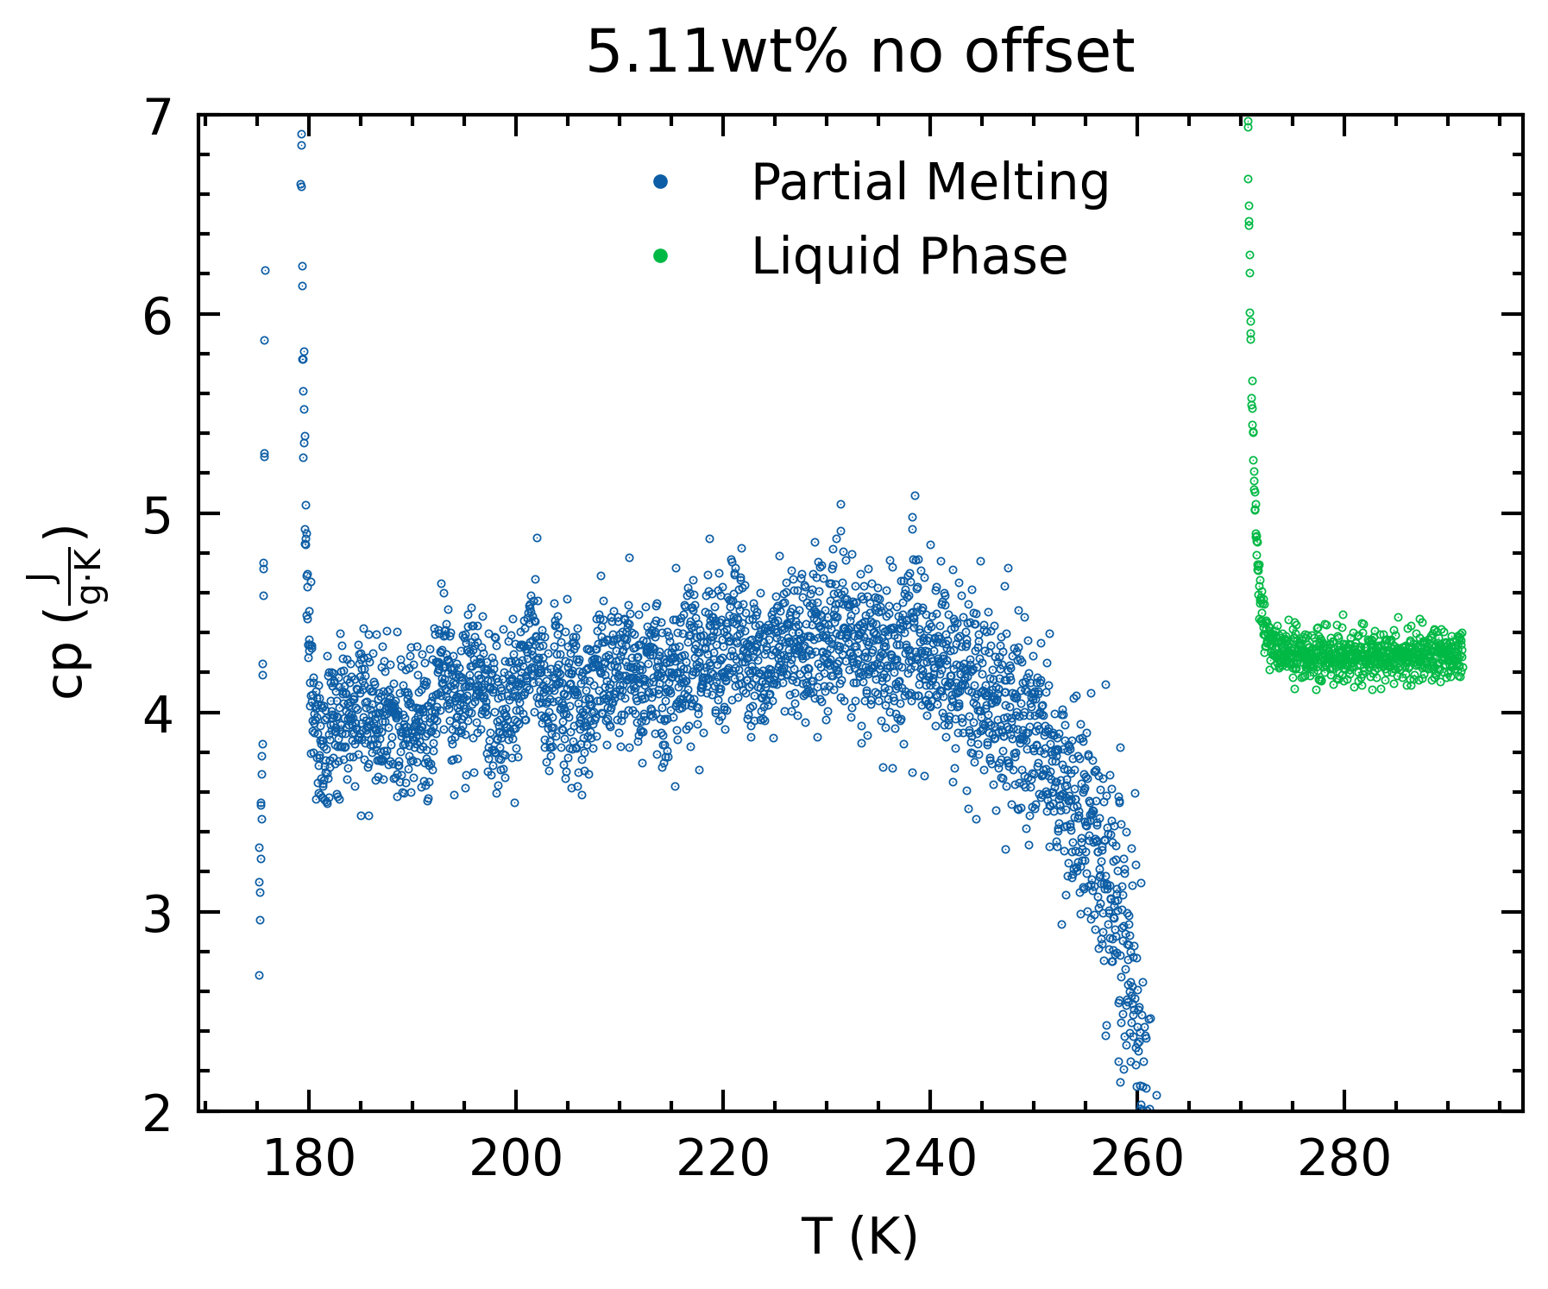
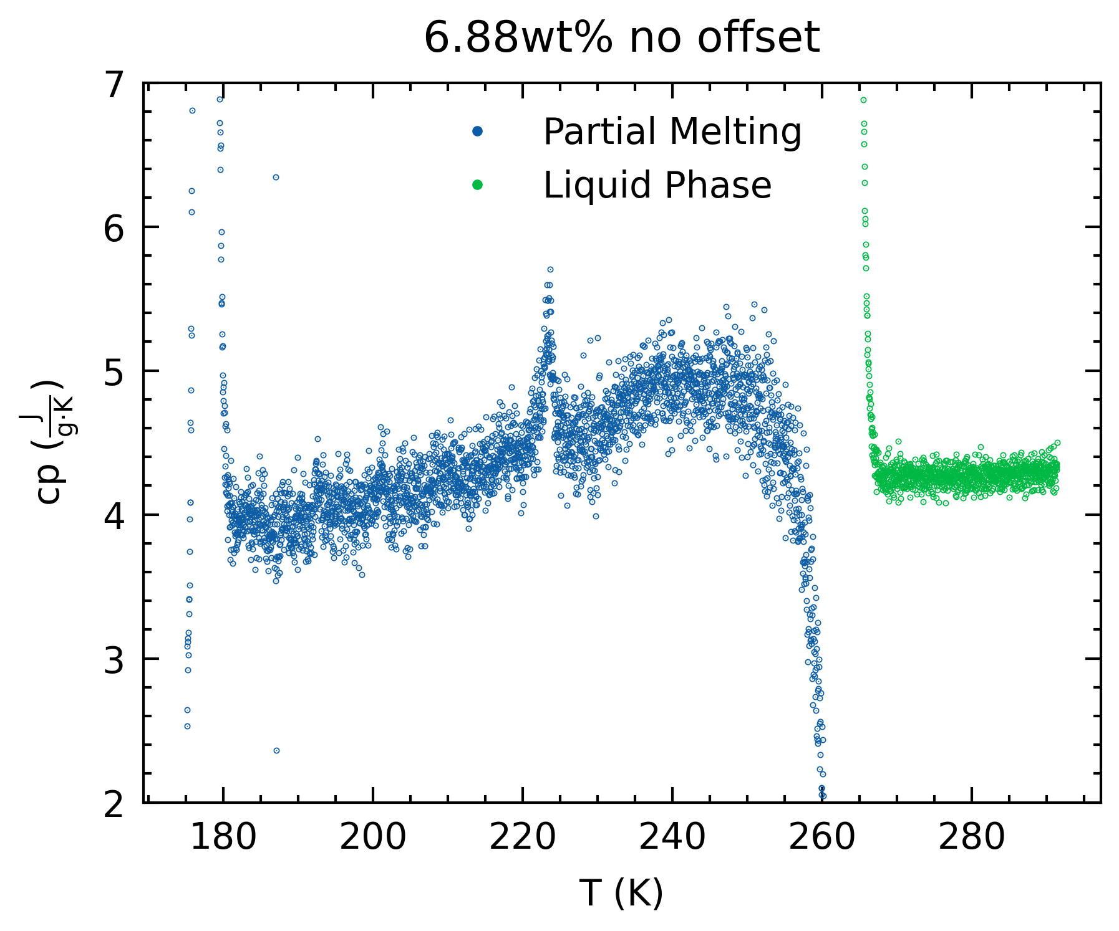
Aside: Specific Heat & wt%
0.9 g/ml density to calculate wt% (top row)
Significant sensitivity of cp based on wt% (Fc, heat to melt ice)

Slide 10
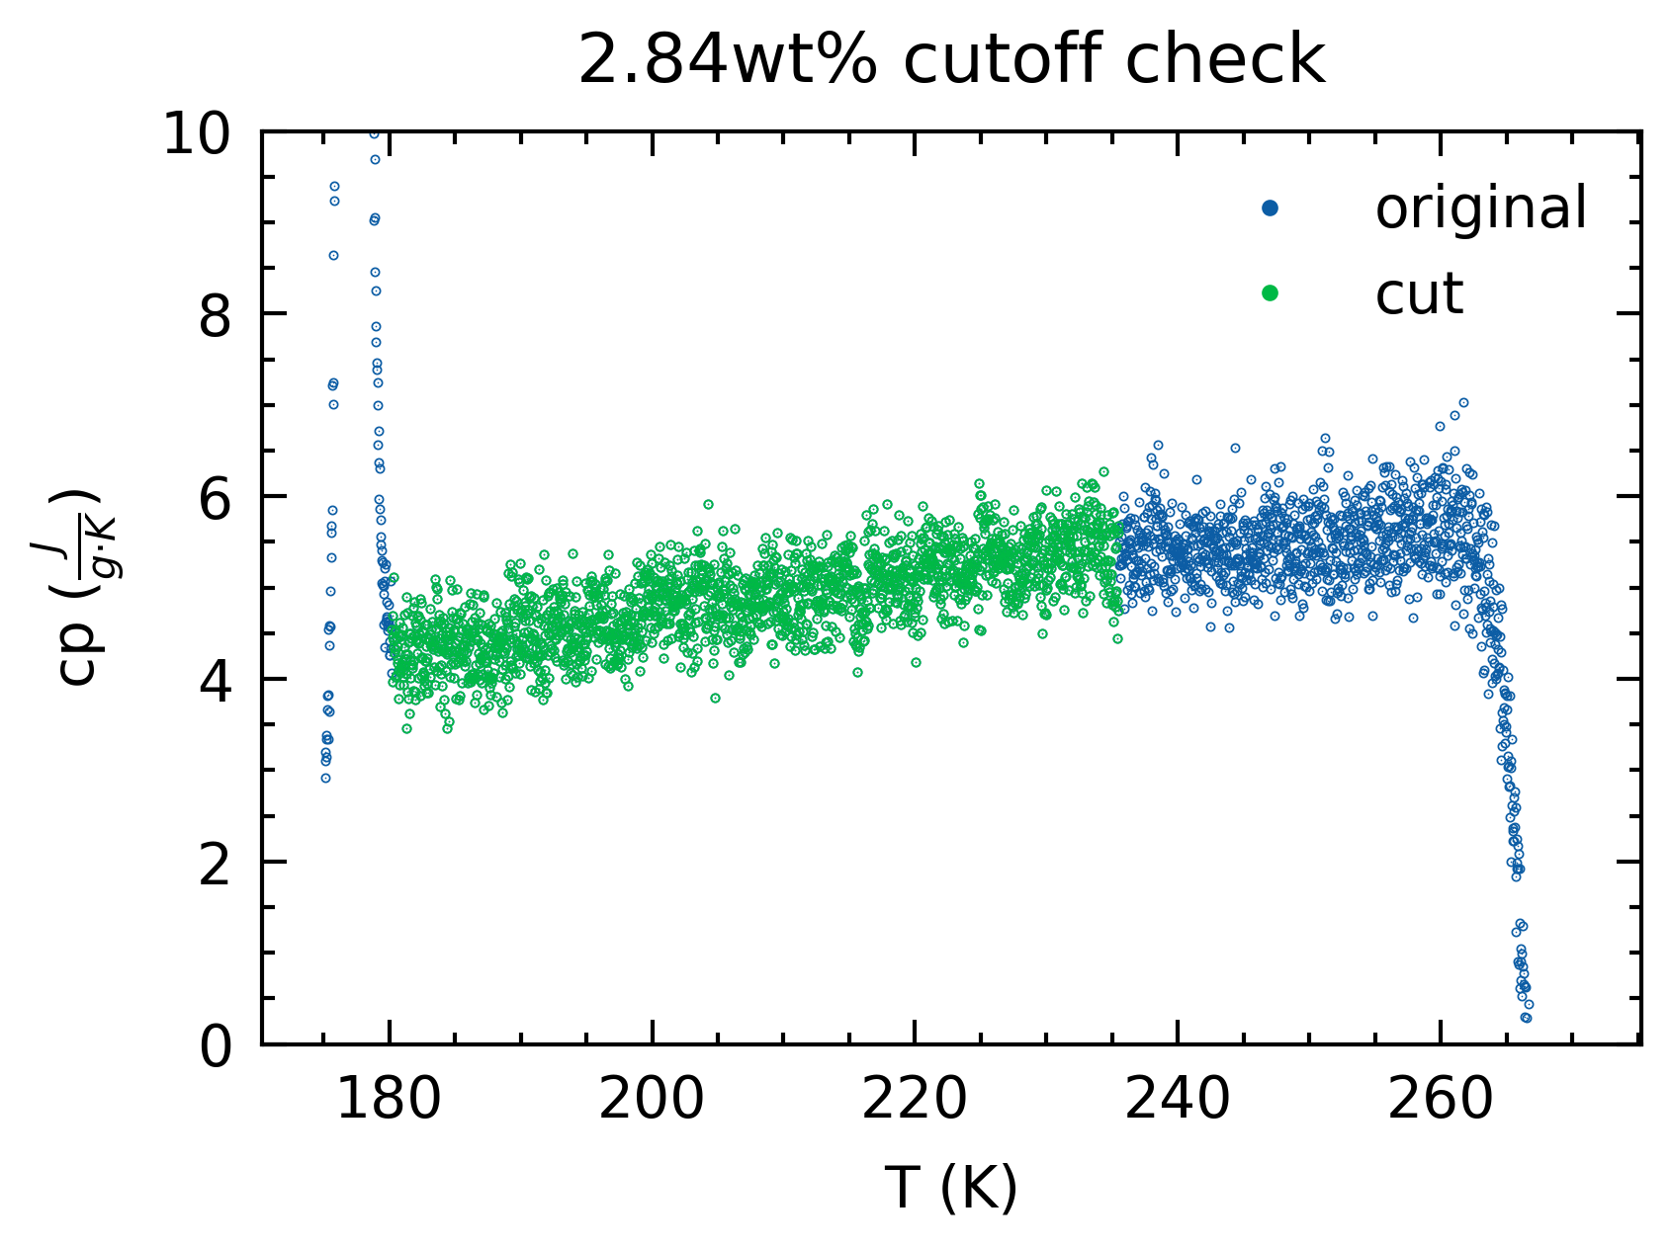
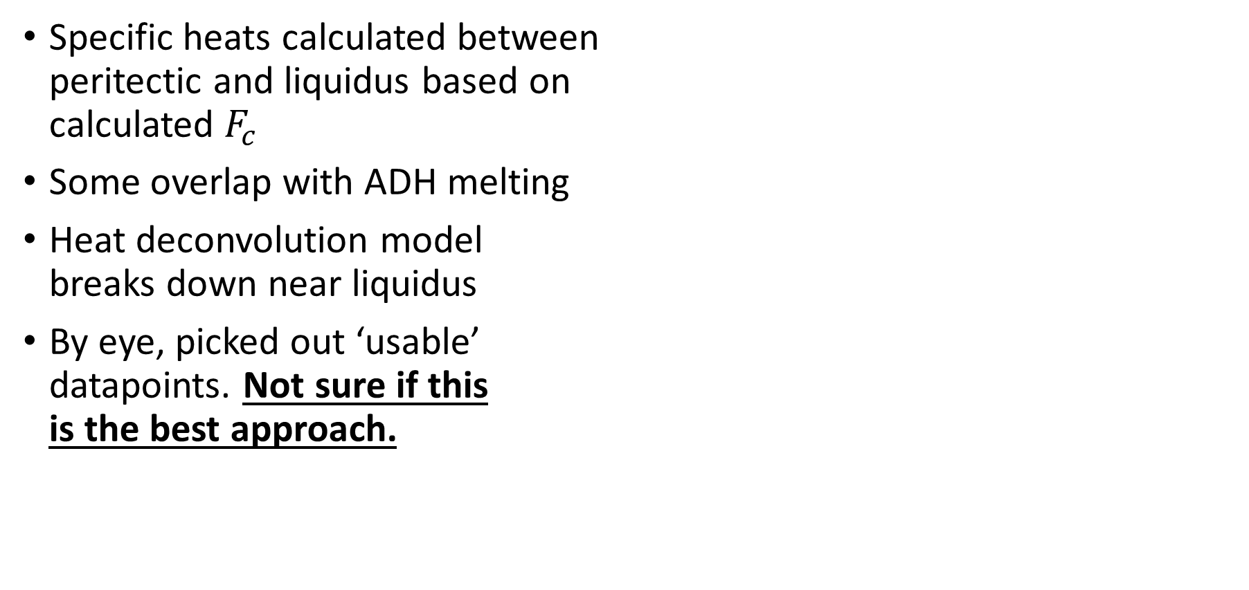
Specific Heat
Specific heats calculated between peritectic and liquidus based on calculated $F_{c}$
Some overlap with ADH melting
Heat deconvolution model breaks down near liquidus
By eye, picked out ‘usable’ datapoints. Not sure if this is the best approach.

Slide 11
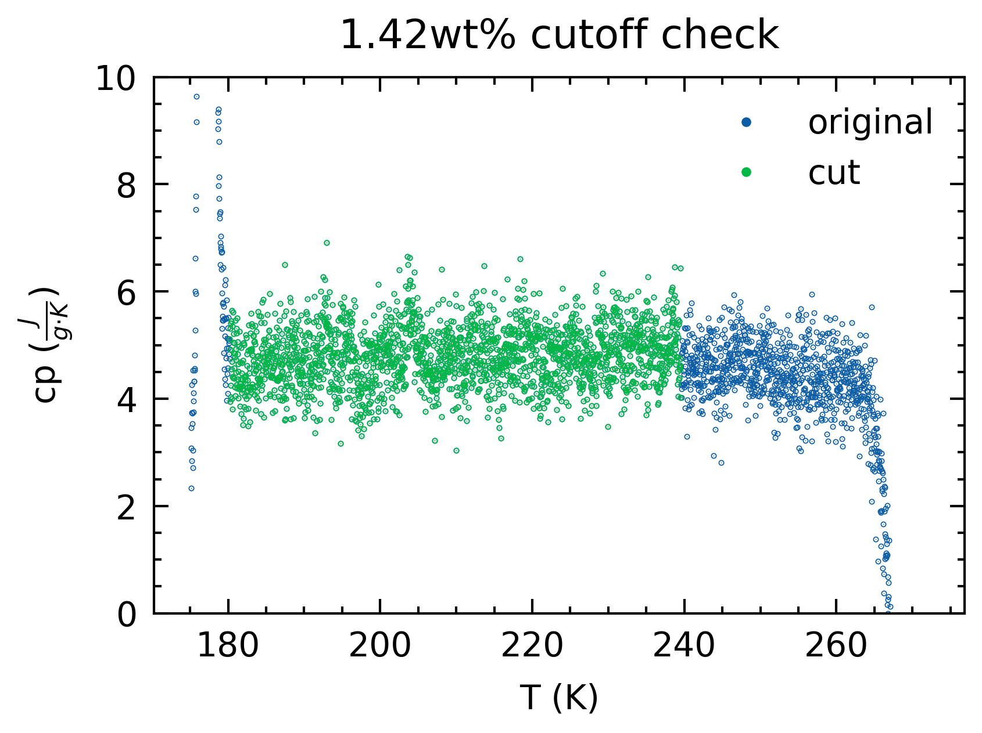
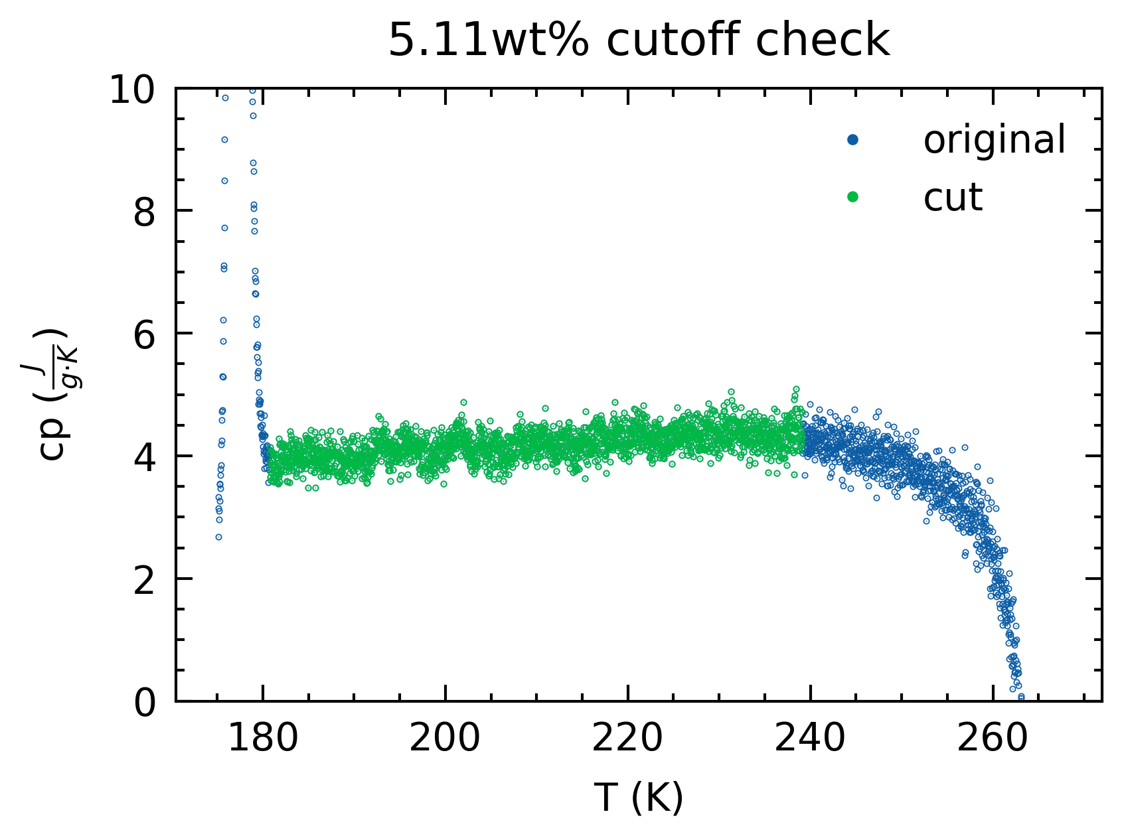
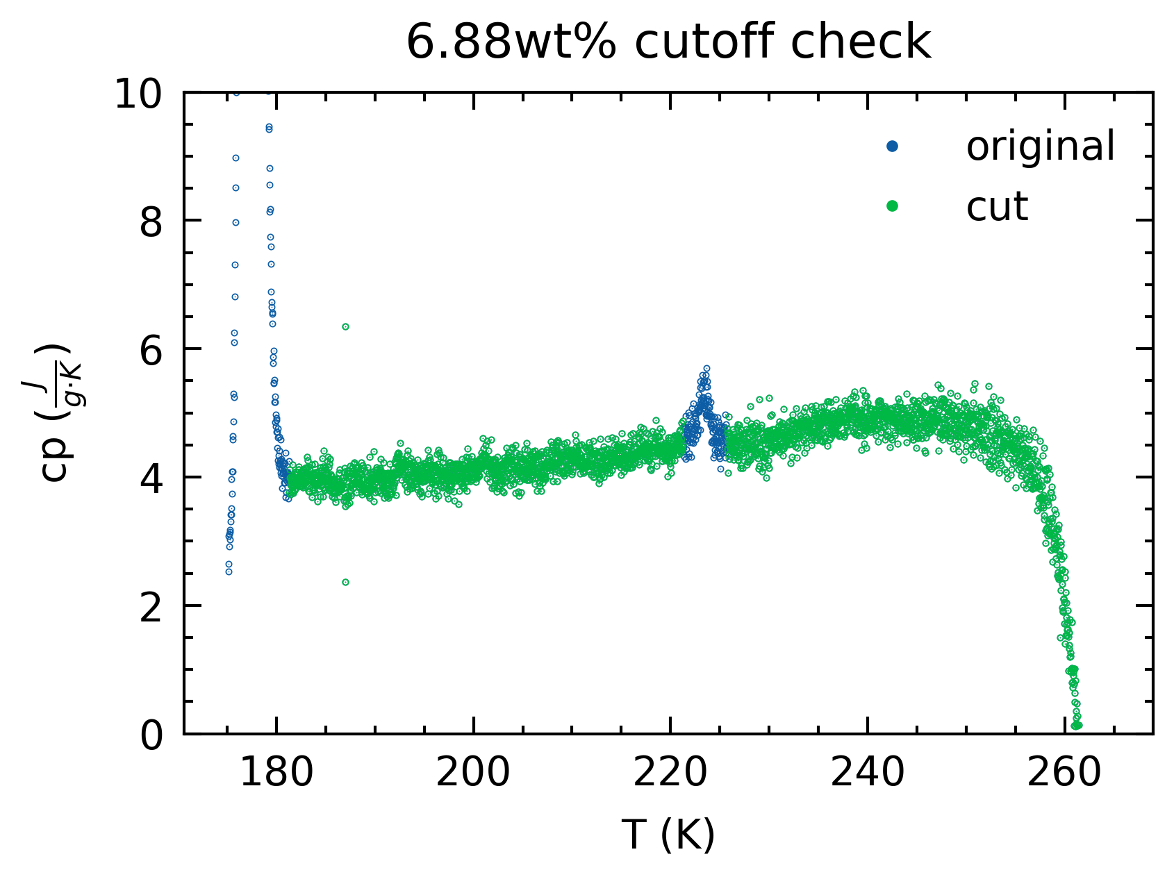
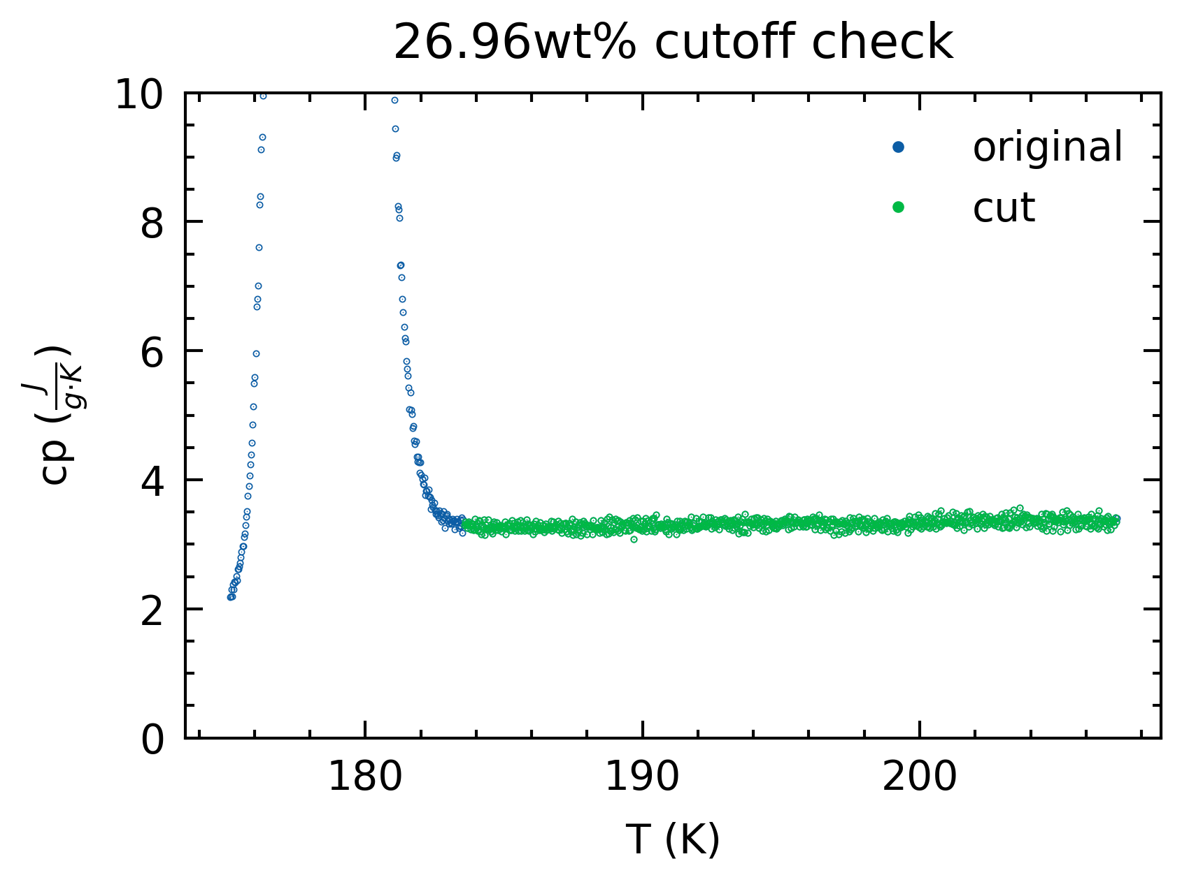
Specific Heat

Slide 12
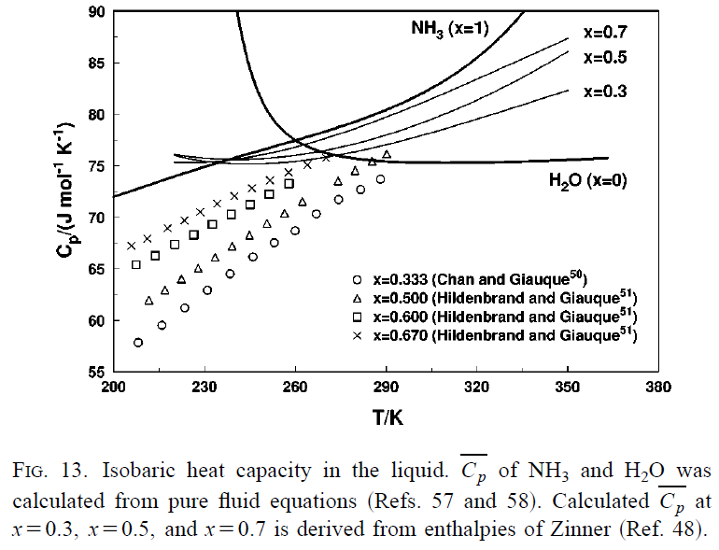
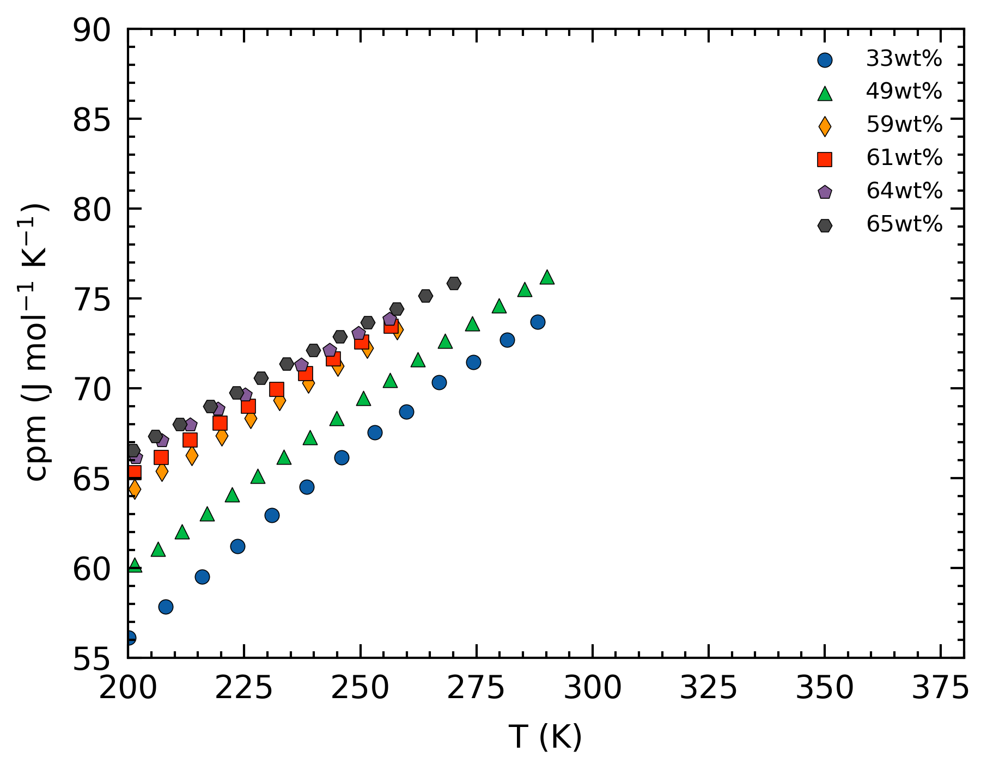
Specific Heat
Literature values: Hildenbrand (1953), Chan (1964) and Giauque
Could not find source for Zinner 1934

Slide 13
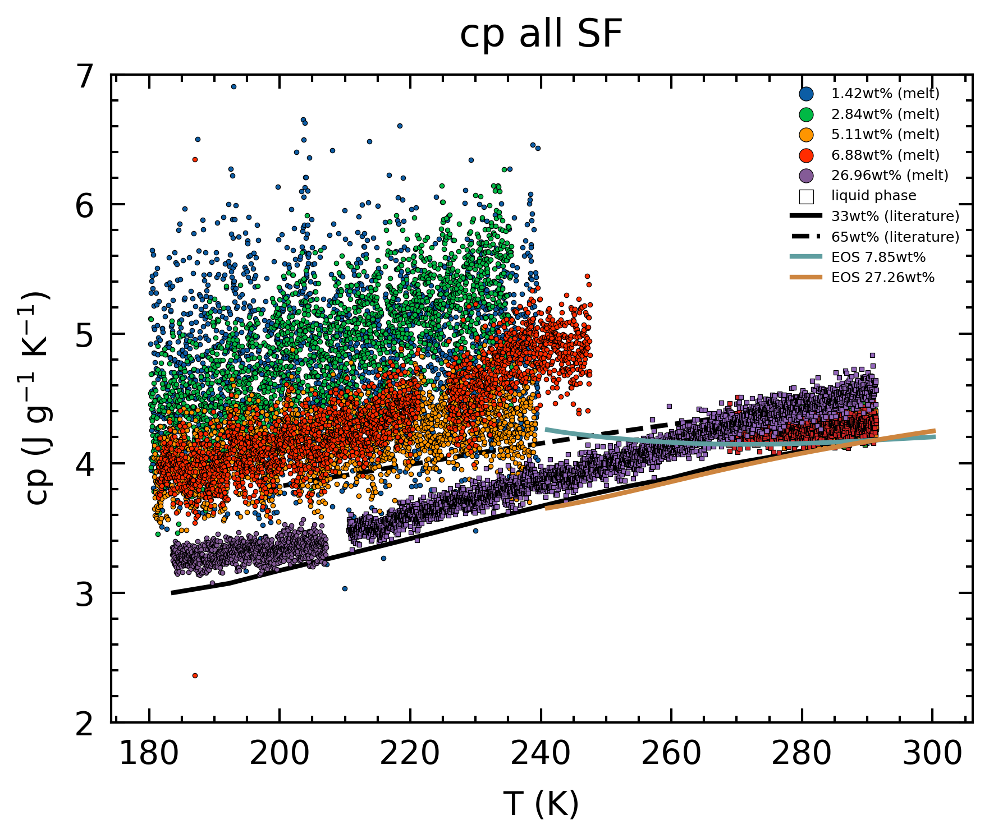
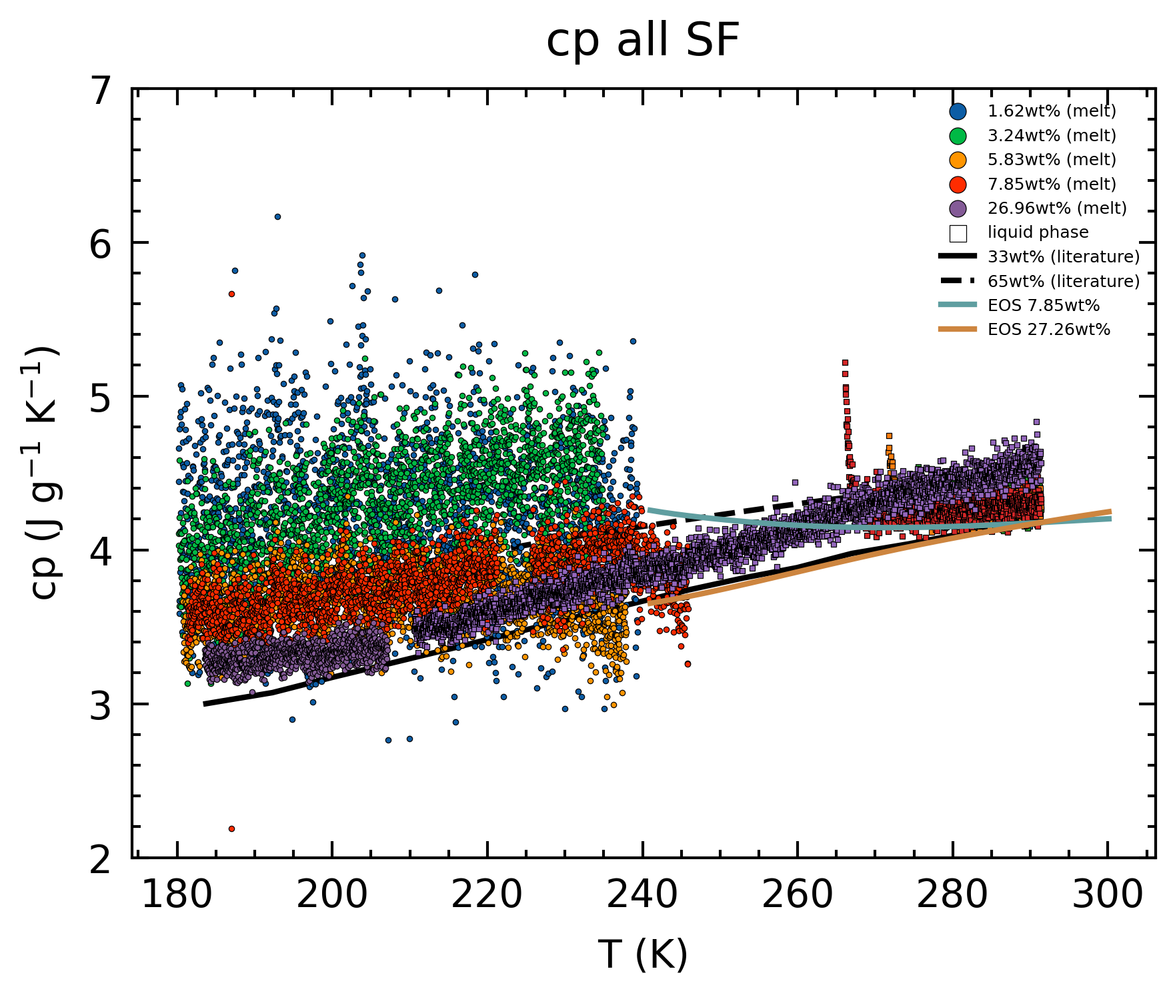
Specific Heat
Overall

Slide 14
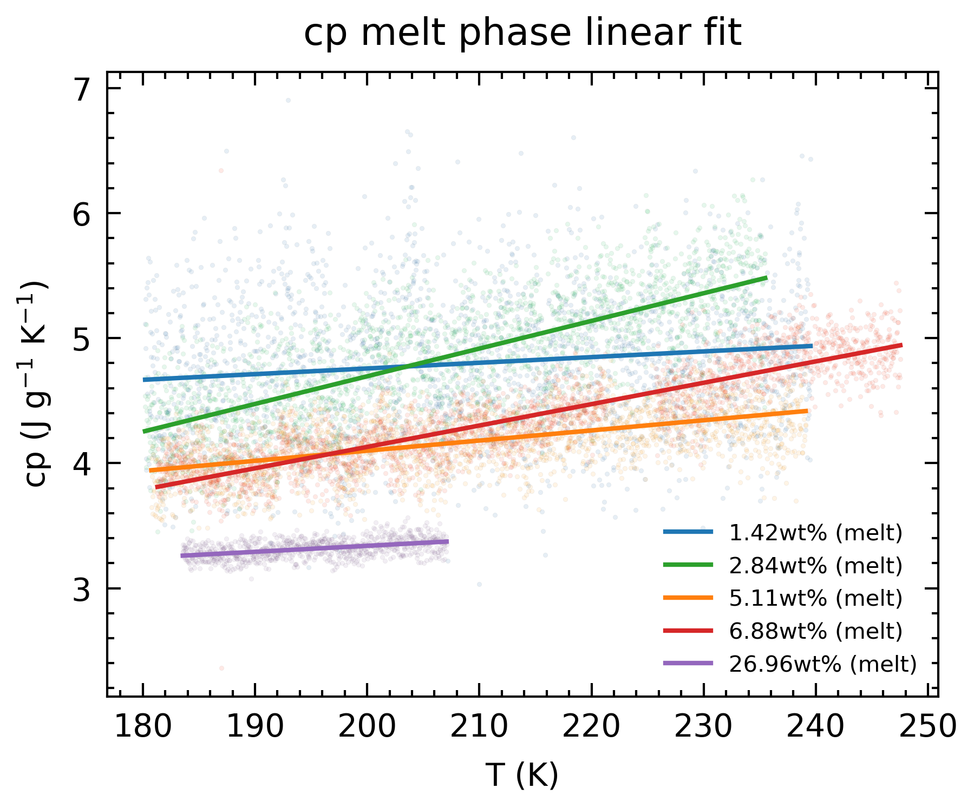
Specific Heat
Melt phase: Difference in slopes
Not sure why
Possible avenues
Check if differences arise in thermogram
Linear combination offsets

Slide 15
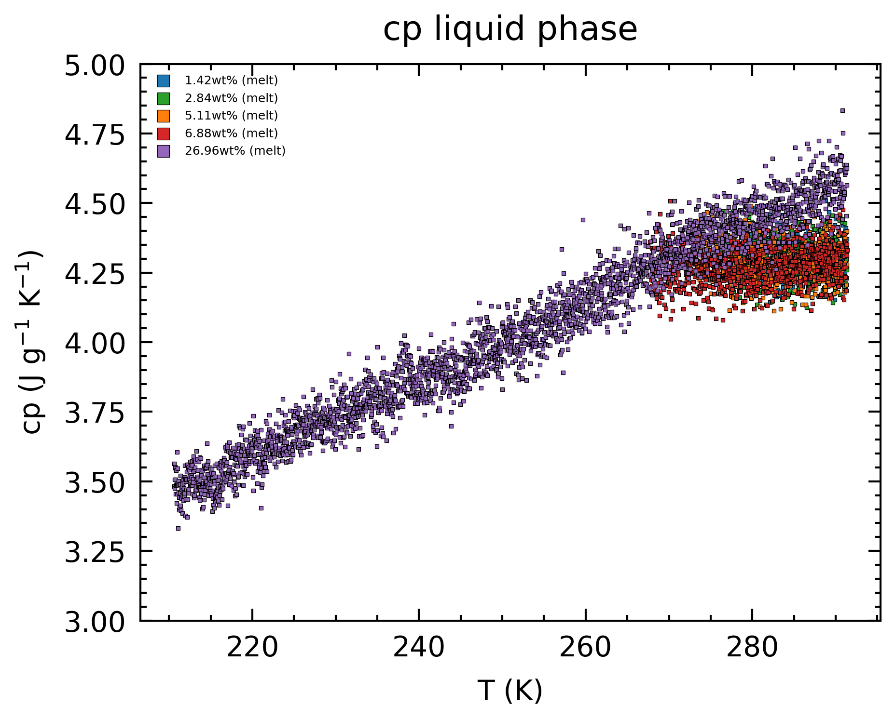
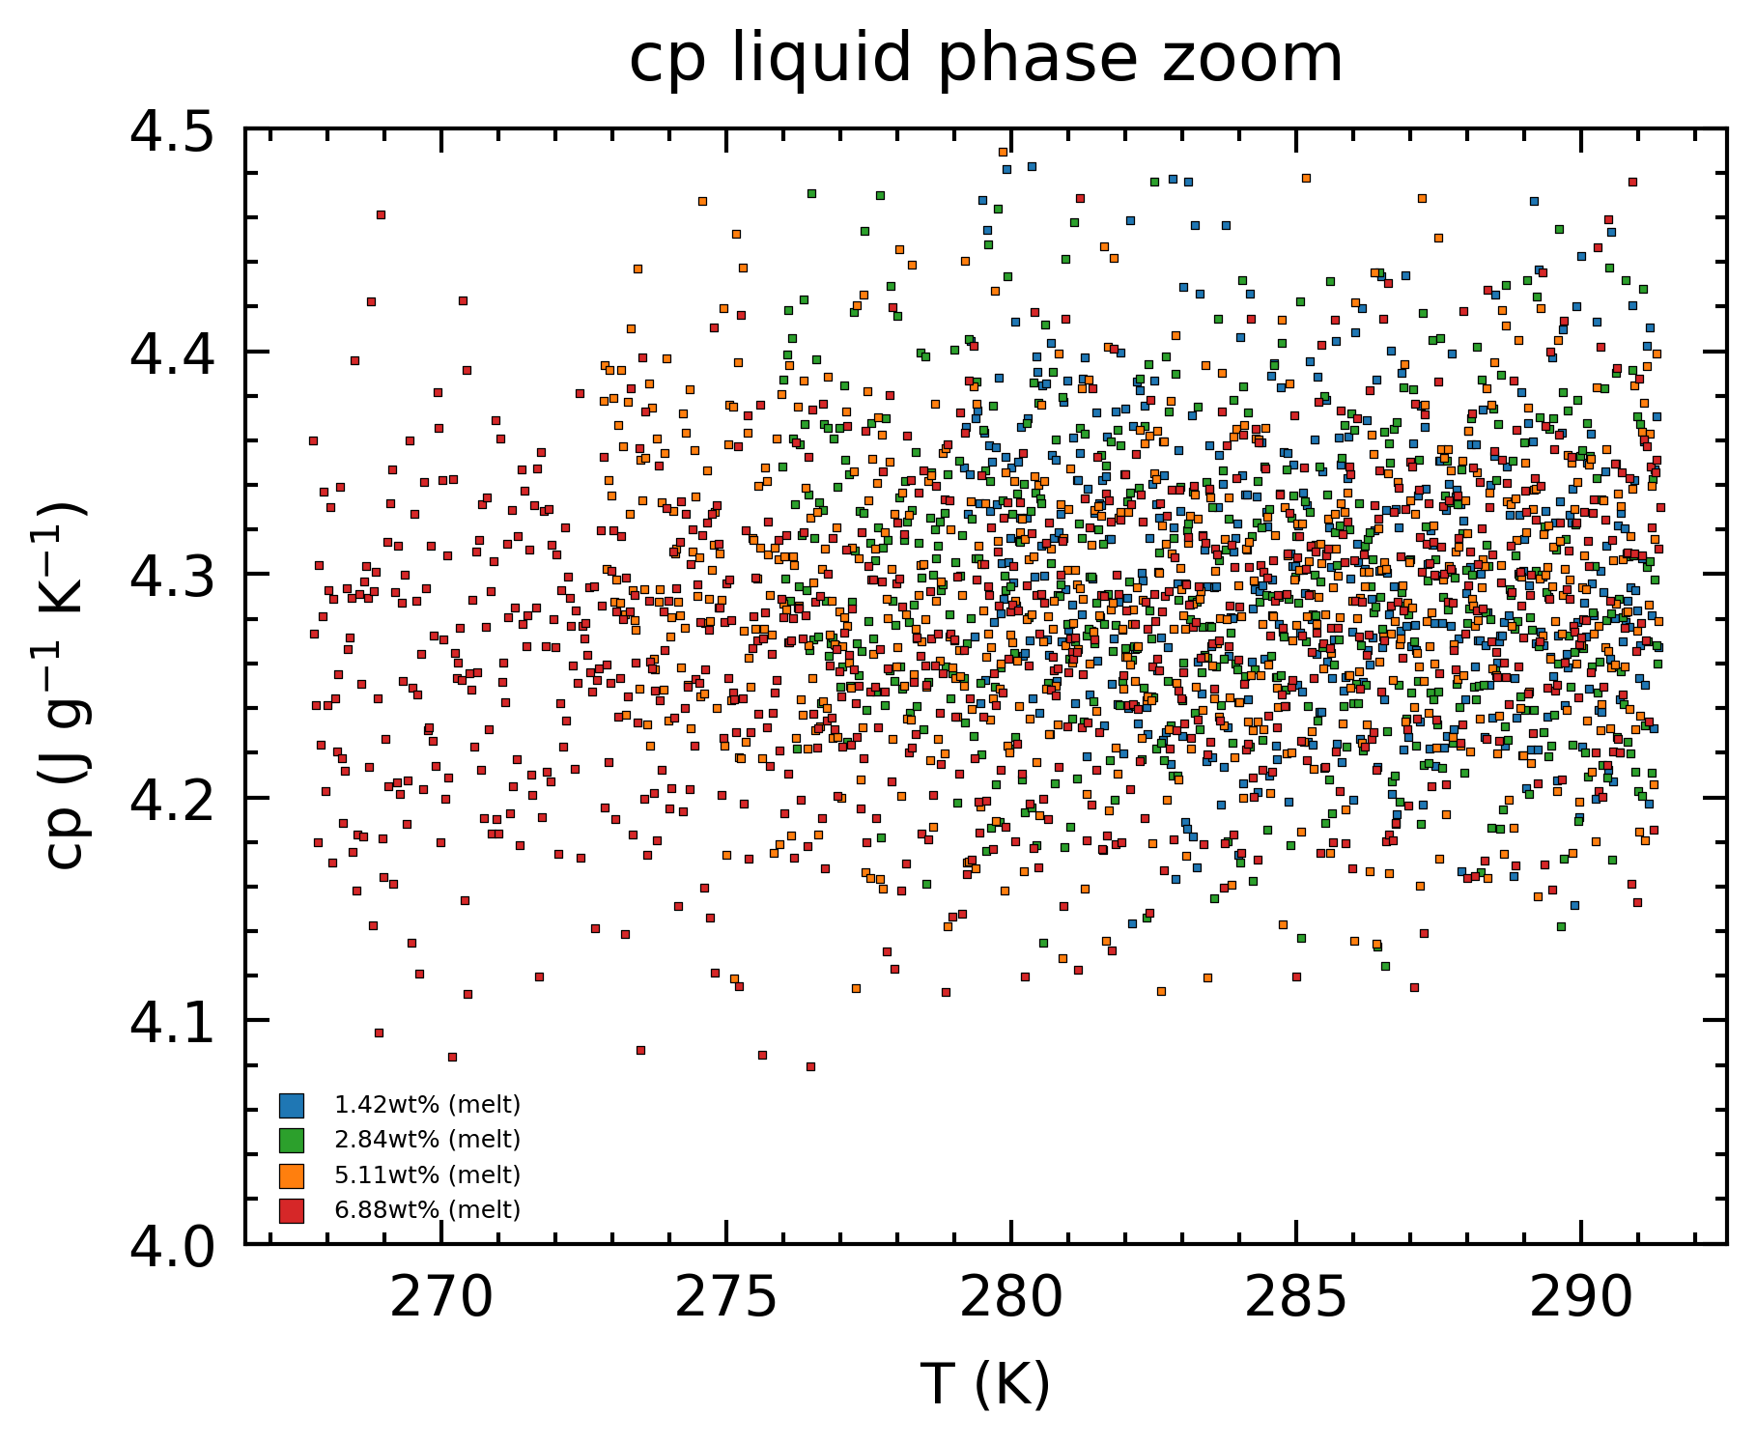
Specific Heat
Pure Phase: Similar values for low conc.
Not sure why

Slide 16
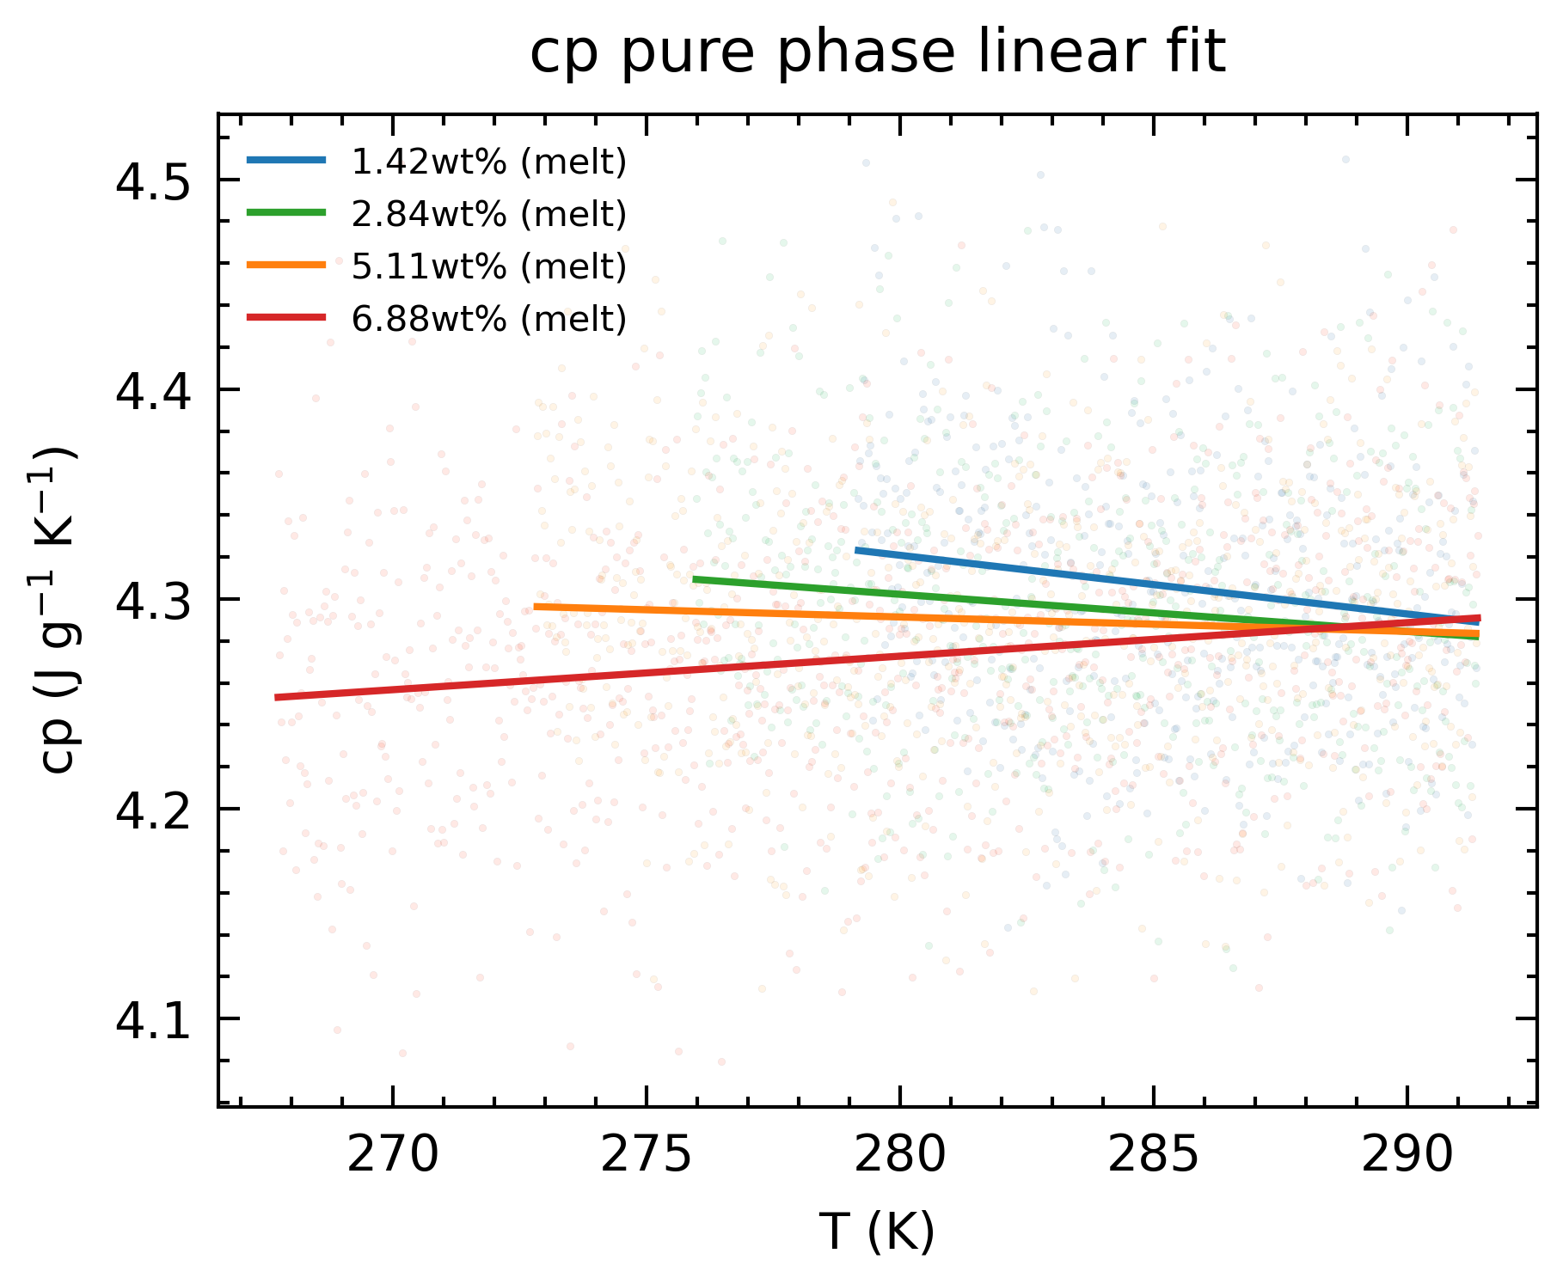
Specific Heat
Pure Phase: Similar values for low conc.
Not sure why
Fit is not useful, but perhaps suggest higher conc., lower cp?

Slide 17
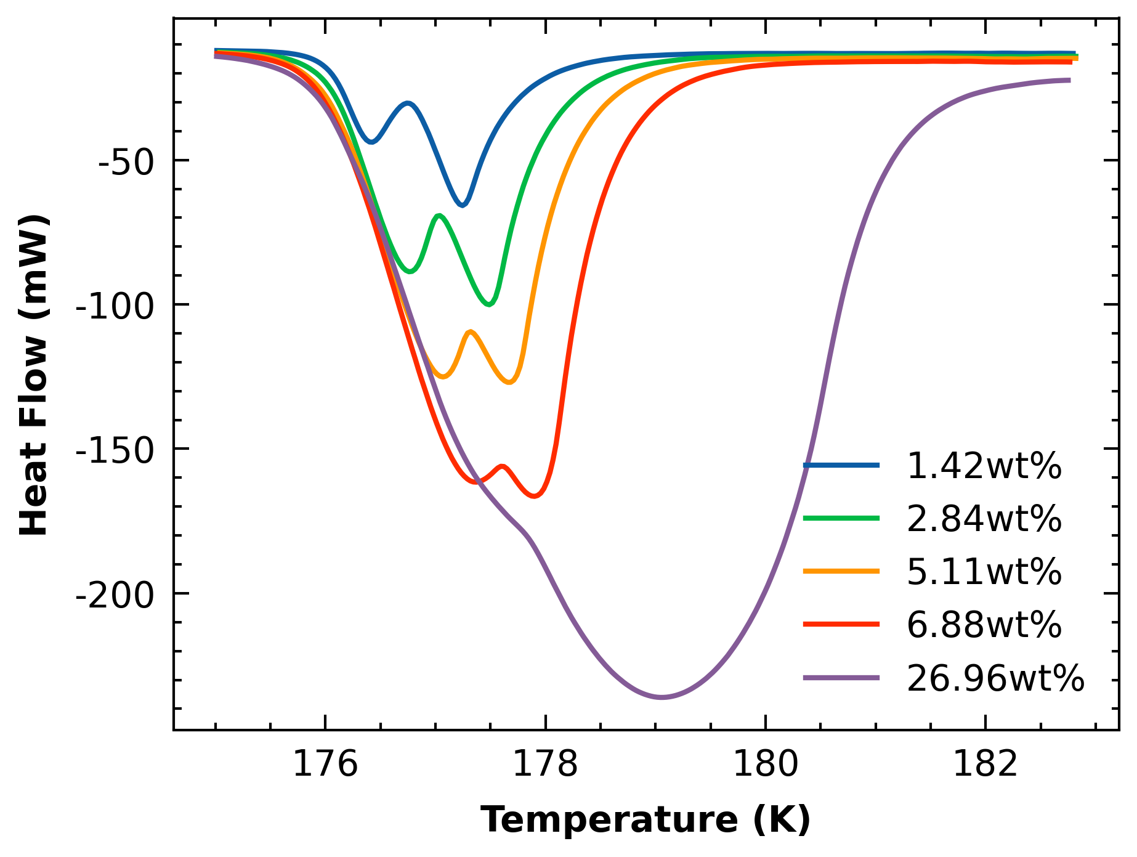
Specific Heat
AMH Melt: double peak

Slide 18
Summary of Questions
How should we deal with the density?
Trust our measurements
How should determine which data to keep in the melt phase?
How do we resolve the higher cp in melt phase?
How do we resolve the similar cp in pure phase?
How do we resolve the seeming crossover in cp over concentrations?

Slide 19
Summary of Actions
Get ice specific heat from 0wt% run
Get running average of pure liquid regime
Get running average of melting regime
Check for periodicity signals
Check density correlation with concentration in seafreeze EOS / Tillner-Roth
Check the precision /uncertainty of pipette and mass balance (density measurement)
Re-run experiments
in between conc (10-20wt%)
Higher T range (~320K)
1mL run to check for ADH double peak (low heat flow) (2.84wt%)
Double check set of heatflow correction coefficients (check manual/dropdown menu, or old expts with low heat flow (meteorite runs)

